Slide 1
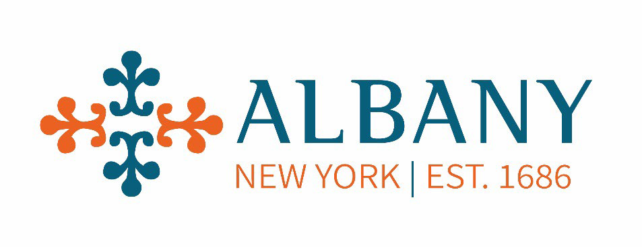


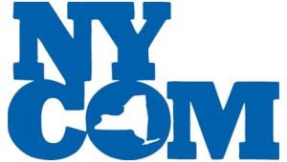

BRIDGING THE GAP
IN THE GENERATIONAL WORKFORCE
Presented @ NYAPCSO Conference 6/12/2024

Slide 2

Agenda
Agenda
2
Generations
Shifts in the labor market dynamics
Meet the new team
Millennial Gen Z in the workforce
Retaining new generation
Why are they leaving
How to make them stay
Recruiting
Sergio Panunzio, CPWM, CPM
Commissioner Albany DGS
Commissioner Sergio Panunzio has had an illustrious career in municipal government spanning over four decades, marked by a diverse array of managerial roles. Armed with a degree in sociology and a minor in organizational psychology from Centenary University, his academic background has equipped him with a nuanced understanding of human behavior within organizational settings. In recent years, Commissioner Panunzio has shifted his focus to studying the evolving dynamics of the regional generational workforce within the public sector. Recognizing the significance of this demographic shift, he has conducted extensive research to understand its implications for organizational culture, leadership, and service delivery. His contributions in this area have been recognized by his peers, as evidenced by his role as a member of the NYCOM Public Works Advisory Committee.

Slide 3
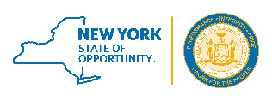
GENERATIONS
June 13, 2024
3

Slide 4
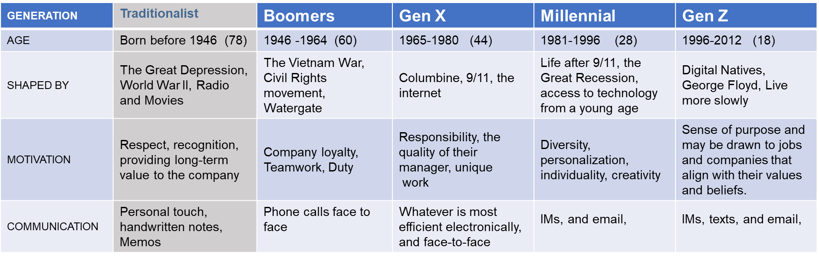
GENERATIONS THROUGHOUT THE YEARS
4
Contrasts amongst generations
The Silent Generation - WWII (Witnessed) - Early Years of the Cold War - The Korean War – Prohibition - Great Depression
Baby Boomers - The Civil Rights Movement
- Assassinations of JFK, RFK, MLK Jr. and Malcolm X - The Vietnam War
Generation X - The Final Years of the Cold War - The Fall of the Berlin Wall - Oklahoma City Bombings - HIV/AIDS Epidemic
Millennials - Y2K - 9/11 - Columbine School Shooting - The Great Recession (Came of Age)
Generation Z - The Great Recession
Each generation tends to be shaped by significant events and cultural shifts that occur during their formative years.
(Witnessed) - Sandy Hook School Shooting - COVID-19 Pandemic (Came of Age) Generation Alpha - COVID-19 Pandemic (Witnessed)

Slide 5
Environmental Changes
5
Environmental changes play a crucial role in shaping societal behavior and consequently impact the workforce dynamics. These changes encompass a broad spectrum of factors beyond just technological advancements or organizational practices.
For example, economic downturns can significantly affect job availability, career opportunities, and job security, leading to changes in workforce behavior such as increased job mobility, heightened competition for employment, or a greater emphasis on skill development and adaptability.

Slide 6
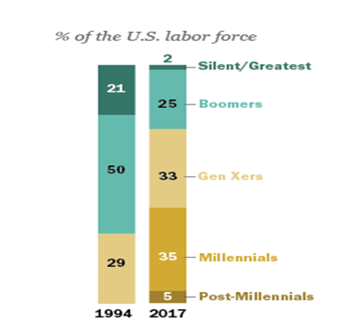
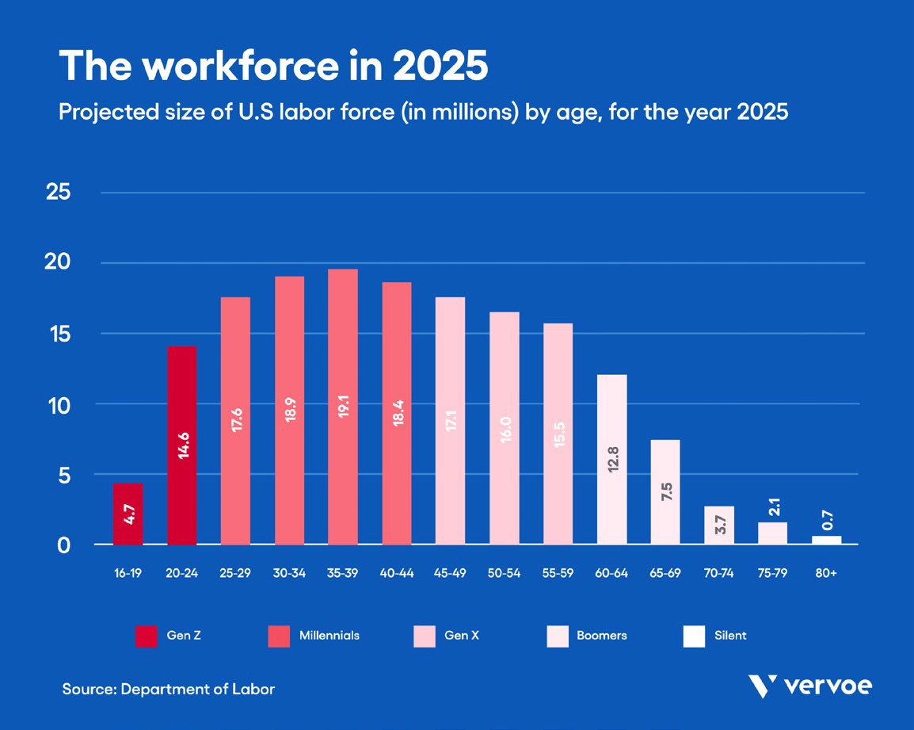
Changes
6
Demographic changes, such as aging populations or shifts in immigration patterns, can alter the composition of the workforce, influencing aspects like labor supply, diversity, and intergenerational dynamics.
This can prompt adjustments in recruitment strategies, training programs, and workplace policies to accommodate the needs and preferences of different demographic groups.
Cultural shifts, including changing attitudes towards work- life balance, diversity and inclusion, and environmental sustainability, can also impact workforce behavior.
Organizations may need to reassess their practices and policies to align with evolving cultural expectations and values, fostering a more inclusive and socially responsible work environment.

Slide 7

Organizations must remain adaptable and forward-thinking
7
This may involve investing in education and skill development, promoting diversity and inclusion, embracing technological innovation, and fostering sustainable practices that align with evolving societal values and priorities.
By recognizing and addressing these environmental changes, stakeholders can better prepare for the future of work and ensure that the workforce remains agile, inclusive, and responsive to emerging challenges and opportunities.

Slide 8

COVID 19
8
The COVID-19 pandemic has indeed emerged as a defining environmental factor that has shaped the behaviors and priorities of the next generation. Its impact has been multifaceted, extending far beyond public health to encompass economic, social, political, and psychological dimensions.
Economic Impact:
The pandemic caused widespread disruptions to global supply chains, businesses, and industries, resulting in job losses, economic recessions, and financial instability for many individuals and communities. It accelerated trends towards remote work, e-commerce, and digital transformation, reshaping the nature of employment, consumer behavior, and economic activity.
Housing Impact
Housing costs experienced fluctuations during the pandemic, influenced by factors such as changes in demand, migration patterns, and government policies aimed at addressing housing affordability and stability.

Slide 9
COVID 19
9
Social Impact:
The pandemic prompted unprecedented changes in lifestyle, work, and social interactions, leading to feelings of isolation, anxiety, and uncertainty among individuals.
Political Impact:
The pandemic has tested the capacity and effectiveness of governments and institutions in managing public health crises, leading to debates over policy responses, governance structures, and leadership accountability.
Psychological Impact:
The pandemic has taken a toll on mental health, contributing to increased rates of stress, depression, and other psychological disorders among individuals of all ages.
The COVID-19 pandemic represents a watershed moment that will leave a lasting imprint on the next generation, influencing their attitudes, behaviors, and responses to future challenges.

Slide 10
June 13, 2024
10
Shifts in the labor market dynamics.
Defining “Phenomenon's” of Covid-19

Slide 11
Phenomenon(s) THE GREAT RESIGNATION
11
The great resignation
The phenomenon dubbed "The Great Resignation" has garnered significant attention in recent years
Why did it happen?-Skills Mismatch:
Many older workers feel they can't keep up with the evolving skill requirements of the modern workplace. Rapid technological advancements, shifts in industry demands, and changing job roles have created a skills gap, leaving some workers feeling ill-equipped or undervalued in their current positions.
Impact of COVID-19:
The COVID-19 pandemic has acted as a catalyst for The Great Resignation, amplifying existing concerns and
prompting individuals to reassess their career priorities.
Why did it happen? Burnout and Stress:
The prolonged stress and uncertainty brought about by the pandemic have exacerbated feelings of burnout and dissatisfaction among workers. The Great Resignation reflects broader shifts in societal attitudes towards work, with many individuals seeking greater autonomy, purpose, and fulfillment in their careers.

Slide 12
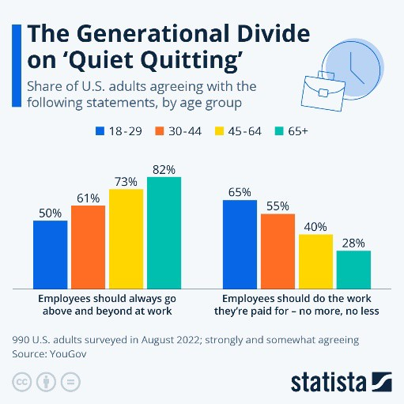
Phenomenon(s)- THE GREAT UNRETIREMENT
12
The great un-retirement
The phenomenon dubbed "The Great Un-retirement" has garnered significant attention in recent years
Why did it happen?-Cost of living
The increasing cost of living, including housing, healthcare, and other essentials, is making it financially challenging for retirees to sustain their lifestyle solely on savings or fixed retirement income.
Phenomenon(s)- THE SILENT QUITTING
  The silent quitting
The phenomenon dubbed "The Silent Quitting" has garnered significant attention in recent years
What is it?
Doing the minimum requirements of one’s job and putting in no more time, effort, or enthusiasm than absolutely necessary.
  Gallup's 2023 "State of the Global Workplace" report states that 59% of the global workforce consists of quiet quitters.
  Critics question whether quiet quitting is a new trend or simply a trendy new name for worker dissatisfaction.

Slide 13
Meet the new team
June 13, 2024
13

Slide 14

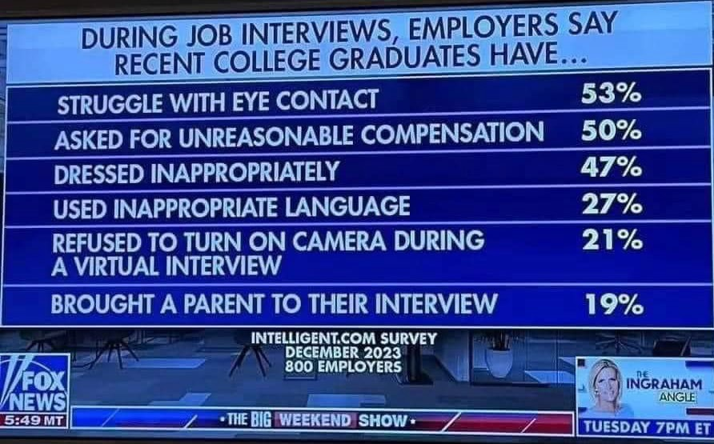



Today’s workplace demographics
14
Traditionalist= <3 %
Baby boomers = 15% GEN X = 33%
GEN Z = 40%

Slide 15

Attributes to the new Generations
The social construction of the new generation
15
The transition was led to what some psychologists term "helicopter parenting" or "snowplow parenting," where parents attempt to clear all obstacles from their children's paths to ensure their success and happiness.
While this approach may stem from a well-intentioned desire to provide the best opportunities for children, it can inadvertently hinder their development of essential life skills such as resilience, problem-solving, and self-sufficiency.

Slide 16

Results of attributes
As a result, some children raised in this environment may struggle with independence and perseverance as they grow older. They may become accustomed to having everything taken care of for them and lack the confidence or skills to tackle difficult tasks on their own.
16
The underlying message [the parent's] over-involvement sends to kids is
‘My parent doesn't trust me to do this on my own.”
Over-parenting is associated with higher levels of child anxiety and depression.
Parents who are overly controlling can impair their child's ability to regulate emotions and behavior.
Children who have always had their social, academic, and athletic lives adjusted by their
parents can become accustomed to always having their way, which can result in a sense of entitlement.
Researchers found the same was true for college students whose parents were over-involved

Slide 17
Now they are our employees
17
In 2019 the oldest Millennials turned 40, which means that they have been part of adult life for a while.
Stressed, in debt, and in demand, These generations are rethinking their priorities—and their careers—as they enter middle age.
Recognizing and respecting the diverse priorities and life stages of employees in a multigenerational workforce is crucial for fostering an inclusive and supportive work environment. Each individual brings unique experiences, responsibilities, and challenges to the table, and acknowledging this diversity is essential for promoting employee well-being and productivity.
By understanding that employees may be at different stages in their personal and professional lives, employers can implement policies and practices that accommodate varying needs.

Slide 18
Addressing generational stereotypes and assumptions
18
By recognizing and valuing the unique perspectives, experiences, and contributions of individuals from different generations, organizations can create a more inclusive and supportive environment for all employees.
Education and Awareness: Providing training and resources to employees to help them understand and recognize generational biases and stereotypes.
Promoting Dialogue and Understanding: Encouraging open and respectful communication among employees of different generations to foster mutual understanding and empathy.
Avoiding Generalizations: Emphasizing the importance of recognizing individuals as unique and complex individuals, rather than making broad generalizations based on age.
Exploring Overlaps and Commonalities: Acknowledging and exploring the overlaps and commonalities that may exist between generations.
Inclusive Policies and Practices: Reviewing and revising organizational policies and practices to ensure they are inclusive of employees from all generations.

Slide 19
Addressing generational stereotypes and
19
assumptions 2
The potential for "us vs. them" attitudes between different generations of employees. These attitudes can hinder collaboration, communication, and overall teamwork, ultimately impacting productivity and morale. Building trust and fostering positive relationships among employees of different generations is indeed key to overcoming these dynamics. Here are some strategies to promote understanding and collaboration:
Encourage Open Communication: Create opportunities for employees to engage in open and honest dialogue, both formally and informally.
Facilitate Cross-Generational Mentoring: Establish mentoring programs or informal buddy systems that pair employees from different generations.
Promote Mutual Respect: Emphasize the value of each individual's contributions, regardless of age.
Provide Training on Generational Diversity: Offer training and workshops on generational diversity and inclusion to raise awareness and address stereotypes and biases.
Create Opportunities for Team Building: Organize team-building activities and social events that bring employees together in a relaxed and informal setting.
Lead by Example: Managers and leaders play a crucial role in setting the tone for intergenerational relationships
By fostering a culture of trust, respect, and collaboration, organizations can break down barriers between different generations of employees and create a more cohesive and productive workforce

Slide 20
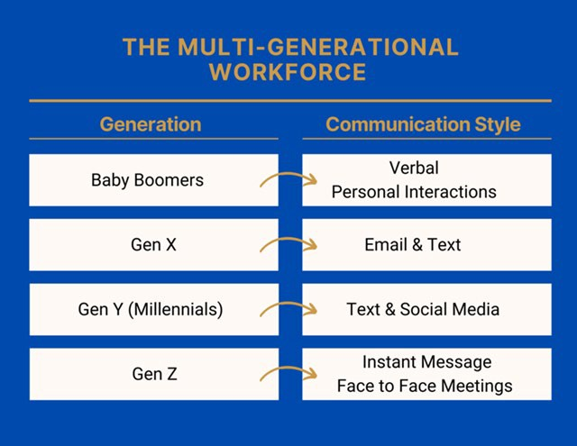
We underestimate our ability to communicate
20
The evolution of communication methods has led to diverse preferences and expectations among employees, especially in a multigenerational workforce. Recognizing and adapting to these differences is crucial for effective communication and minimizing miscommunication.
Use Multiple Communication Channels
Be Clear and Concise
Provide Training and Support
Encourage Feedback and Adaptation
Lead by Example

Slide 21
Millennial Gen Z in the workforce
June 13, 2024
21

Slide 22
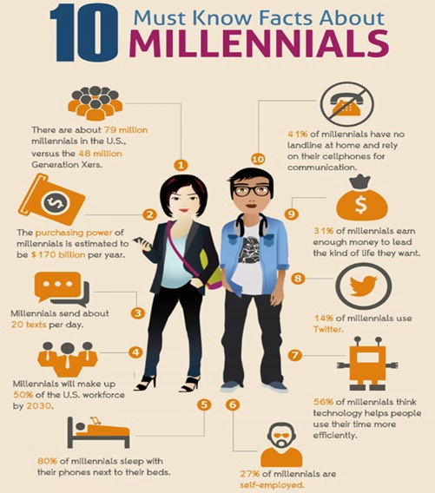
Millennials
22
Comprising some 72 million individuals in the United States, millennials surpassed the baby boomers to become the largest generation of adults in 2019.
Millennials, also known as Generation Y, and the subsequent Generation Z. Millennials, typically born between the early 1980s and mid-1990s, and Gen Z, born in the late 1990s and early 2000s, have indeed grown up in an era marked by rapid technological advancement and widespread access to digital devices.
Constant exposure to technology from a young age has shaped the preferences, behaviors, and expectations of these generations, particularly in the workplace.
Employers have had to adapt their hiring strategies and workplace practices to accommodate the digital fluency and tech-savviness of Millennials and Gen Z.
This includes updating recruitment methods to leverage online platforms and social media, integrating digital tools and technologies into everyday work processes, and fostering a culture of innovation and adaptability.

Slide 23
Millennials
23
Furthermore, Millennials are often characterized by their desire for work-life balance, meaningful work, and opportunities for professional growth and development. They tend to prioritize flexibility, collaboration, and purpose-driven work environments.
Employers who understand and cater to these preferences are better positioned to attract, engage, and retain talent from these generations.
Overall, recognizing the unique characteristics and preferences of Millennials and Gen Z and adapting organizational practices accordingly can help employers stay competitive in today's rapidly evolving workforce landscape.
Send an average of 20 Text per day
50% of the workforce by 2030
80% sleep with their phone next to their bed
41% have no telephone landline at home
31% earn enough money to live 27% are self-employed
14% use Twitter
56% think technology helps people

Slide 24
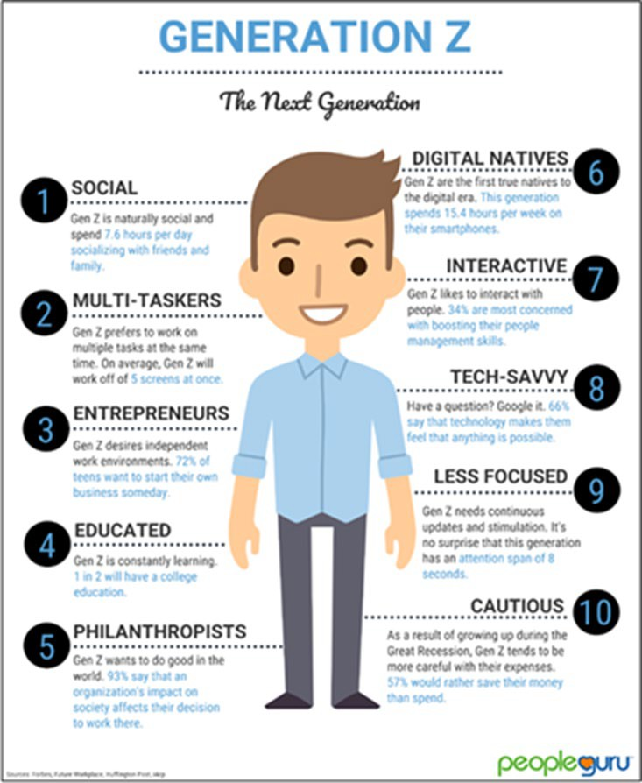
GEN Z
24
Generation Z has been noted for its openness and willingness to discuss mental health issues more openly than previous generations. This shift in attitude toward mental health is indeed significant and has implications for how workplaces approach employee well-being and support.
Generation Z's emphasis on work-life balance and mental well-being reflects a broader societal trend toward prioritizing holistic health and wellness. Rather than solely focusing on job stability or financial success, Gen Z values a more balanced approach that encompasses physical, emotional, and mental well-being.
In response to these shifting priorities, many forward-thinking organizations are implementing policies and initiatives aimed at supporting employee mental health, such as offering mental health days, providing access to counseling services, promoting work-life balance through flexible scheduling, and fostering a culture of open communication and support.

Slide 25
Gen Z struggles more with focusing- Why? Simply because Gen Z has too many distractions going on.
25
7.6 Hours of day socializing
Multi-taskers ( 5 screens at once)
72% want to start their business
1 in 2 have a college education
93% of an organization’s impact on society affects their decision to work there
15.4 Hrs. x week on smartphones
34% want to boost their people skills
66% feel technology makes them feel anything is possible
Attention span of 8 seconds
57% would rather save their money than spend it
Gen Z has never been without the Internet and needs to know the “why” for everything. They want to be a part of something bigger.

Slide 26
Retaining new generation
June 13, 2024
26

Slide 27

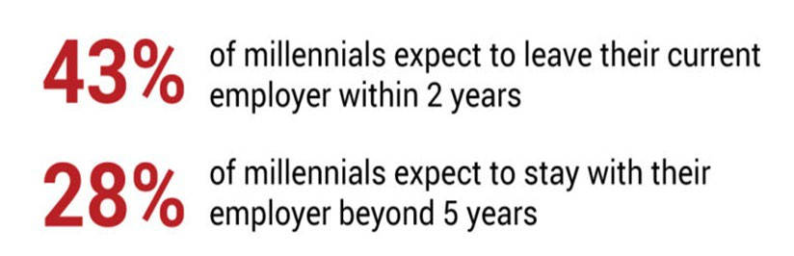

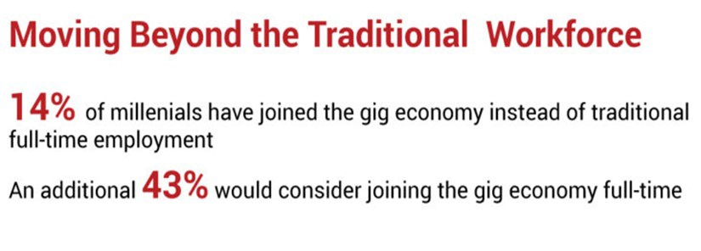
Current market
27

Slide 28
Positive trends
28
Would consider joining the workforce right out of high school, according to new research from Universum,
While only 15% said that they would welcome the idea outright,
47% said they would consider it, and
60 % said they would be open to employers offering education in their field instead of a college degree.
Increase their engagement with the organization
Invest in their professional development.
Give them the right tools.
Get involved in the community and support diversity.
Support work-life balance.

Slide 29
Why are they leaving
June 13, 2024
29

Slide 30
Trends
The high rates of voluntary resignations observed in recent years reflect significant shifts in the priorities and experiences of the workforce, particularly among Millennials and Gen Z individuals
30
Stress and Well-being Concerns: Millennials and Gen Zs report feeling stressed about various aspects of their well-being, including financial, physical, and mental health. The demands of modern life, coupled with economic uncertainty and societal pressures, contribute to feelings of stress and burnout among these generations.
Perks and Benefits: A competitive perks and benefits package is essential for attracting and retaining top talent, especially among Millennials and Gen Zs. Employees increasingly value benefits such as flexible work arrangements, comprehensive healthcare coverage, mental health resources, and opportunities for professional development.
Work-Life Balance: Many Millennials and Gen Zs prioritize work-life balance and seek employers who support their efforts to maintain a healthy equilibrium between their professional and personal lives. Feeling overworked or unsupported can lead to dissatisfaction and ultimately contribute to turnover.
Limited Career Advancement: Millennials and Gen Zs are eager for opportunities for career growth and advancement. Employers that provide clear pathways for development, mentorship programs, and opportunities for skill-building and advancement are more likely to retain younger talent.

Slide 31
To address these challenges and retain valuable employees, employers should consider implementing the following strategies:
31
Invest in comprehensive perks and benefits packages that prioritize employees' holistic well-being, including mental health support, wellness programs, and financial wellness initiatives.
Foster a supportive and inclusive workplace culture that values work-life balance, recognizes employees' contributions, and provides opportunities for professional growth and development.
Offer flexibility in work arrangements, such as remote work options or flexible scheduling, to accommodate employees' diverse needs and preferences.
Provide resources and support for managing stress and burnout, including access to mental health services, wellness programs, and stress management workshops.
Create clear pathways for career advancement and provide regular feedback and opportunities for skill-building and growth.

Slide 32
How to stops them from leaving
32
Inadequate salary (61% of workers said a salary boost is the main reason they are seeking a new job.)
A perks and benefits package that isn’t competitive
Feeling overworked and/or unsupported
Limited career advancement
A need for better work-life balance
Lack of recognition
Boredom
Unhappiness with management
Concerns about the organization’s direction or financial health
Dissatisfaction with the organization culture
The desire to make a change
More compelling job opportunities at other organizations
Organizational commitment and job satisfaction.
Quality of the employee-supervisor relationship.
Role clarity.
Job design.
Workgroup cohesion.

Slide 33

Exit interviews
33
are a valuable tool for gaining insights into the employee experience and identifying areas for improvement in retention strategies.
Employee Experience: Exit interviews allow departing employees to provide candid feedback about their experiences, including what they liked and disliked about their roles, the company culture, and their interactions with colleagues and management. This feedback can offer valuable insights into the strengths and weaknesses of the organization and help identify areas for improvement.
Identifying Patterns and Trends: By conducting exit interviews consistently and analyzing the feedback over time, employers can identify patterns and trends in the reasons for employee turnover. This information can help pinpoint common issues or challenges that may be contributing to turnover and inform targeted strategies for improvement.
Improving Retention Strategies: The insights gained from exit interviews can inform the development of targeted retention strategies aimed at addressing specific concerns or areas of dissatisfaction among employees.

Slide 34
34
Whether it's improving communication, enhancing career development opportunities, or addressing workplace culture issues, exit interview feedback can guide efforts to enhance employee engagement and retention
Conduct interviews in a timely manner before the employee's departure to capture fresh insights and feedback.
Ensure confidentiality and anonymity to encourage honest and candid responses from departing employees.
Ask open-ended questions that encourage employees to share their experiences, perspectives, and suggestions for improvement.
Act on feedback by analyzing trends, identifying actionable insights, and implementing targeted strategies for improvement.
Communicate the results of exit interviews to relevant stakeholders and demonstrate a commitment to addressing employee feedback.
Maintaining Positive Relationships: Conducting exit interviews in a respectful and constructive manner can help maintain positive relationships with departing employees and preserve their goodwill toward the organization. This can be beneficial for future recruitment efforts, as satisfied former employees may be more likely to speak positively about their experiences and recommend the company to others.
To make the most of exit interviews, employers should:
By leveraging exit interviews as a tool for gathering insights and improving retention strategies, employers can better understand the needs and concerns of their workforce and take proactive steps to enhance employee engagement and satisfaction.

Slide 35
35
In a competitive job market where candidates with in-demand skills have numerous opportunities, employers must prioritize employee retention to retain top talent. Here are some strategies to consider:
Regularly Assess Employee Engagement: Monitor employee engagement and satisfaction through surveys, feedback sessions, and one- on-one meetings. Identify any signs of disengagement or dissatisfaction early on and take proactive steps to address concerns.
Offer Competitive Compensation and Benefits: Ensure that your compensation and benefits packages are competitive within your industry and region.
Provide Opportunities for Growth and Development: Offer opportunities for career advancement, professional development, and skill-building to demonstrate your commitment to employees' long-term growth and success.
Foster a Positive Work Culture: Cultivate a positive and inclusive work culture where employees feel valued, respected, and supported.
Offer Flexibility and Work-Life Balance: Recognize the importance of work-life balance and offer flexible work arrangements, such as remote work options, flexible hours, and generous time-off policies. Empower employees to manage their workloads and personal responsibilities effectively.
Provide Meaningful Work and Purpose: Help employees connect with the mission and values of your organization by providing meaningful work that aligns with their interests and values. Foster a sense of purpose and pride in the work that employees do and recognize the impact of their contributions.
Invest in Employee Well-being: Prioritize employee well- being by offering resources and support for mental health, physical health, and overall well-being. Provide access to wellness programs, counseling services, and resources for managing stress and burnout.

Slide 36
How to make them stay
June 13, 2024
36

Slide 37

How to make them stay
37
Investing in onboarding and mentorship programs, organizations demonstrate their commitment to supporting the success and development of their employees, ultimately driving higher levels of engagement, retention, and performance.
Setting Expectations and Culture
Building Connections and Relationships
Onboarding provides an opportunity for new employees to connect with their colleagues, managers, and other stakeholders.
Accelerating Productivity and Integration
Mentorship and Support.
Promoting Knowledge Sharing and Innovation
Continuous feedback on performance
Recognition and rewards systems
Effective change management
An emphasis on teamwork
Acknowledgement of milestones, big and small

Slide 38
Leadership
38
Promoting and training the best leaders is indeed essential for creating a positive work environment and fostering employee engagement
Impact on Employee Engagement: Leaders play a significant role in shaping the culture, morale, and engagement levels within an organization. Effective leaders inspire and motivate their teams, provide direction and support, and foster a sense of trust and accountability. Conversely, ineffective leaders can contribute to disengagement, turnover, and low morale among employees.
Leadership Training and Development: Many leaders are promoted into their roles based on technical skills or tenure without receiving adequate leadership training. This can result in a lack of essential leadership skills, such as communication, coaching, conflict resolution, and team building. Providing leadership training and development opportunities helps equip leaders with the knowledge, skills, and tools they need to succeed in their roles and effectively engage and motivate their teams.
Driving Employee Engagement: Engaged leaders are more likely to inspire and empower their teams, create a positive work environment, and drive employee engagement and performance. By investing in leadership development and promoting effective leadership practices, organizations can create a culture where employees feel valued, supported, and motivated to contribute their best work.

Slide 39
39
In summary, effective leadership is essential for driving employee engagement and retention. By promoting and training the best leaders, organizations can create a positive and empowering work environment where employees feel motivated, supported, and engaged.

Slide 40
Public service problem
40
A critical issue within the public service sector is the lack of leadership training and development for managers and leaders.
This deficiency can have significant implications for employee engagement, productivity, and overall organizational effectiveness.
Promote and Train the Best Leaders
60% [of leaders] said they never received any training when they transitioned into their first leadership role
50% of managers in organizations are rated as ineffective
Most of our Public Service leaders/ manager did not receive leadership training once they were promoted, but they are the main reason our employees are engaged or disengaged at work.
To address the problem of ineffective leadership in the public service sector, organizations should prioritize leadership training and development initiatives. By investing in the development of managers and leaders, organizations can improve employee engagement, enhance organizational effectiveness, and create a positive and empowering work environment for all employees.
Just because a candidate has seniority or a graduate degree does not mean you are promoting the right person.
Yes, they may have stuck around, and pursuing a graduate degree is rigorous while working full time, but neither of these means they are 100% qualified to be a leader

Slide 41
Recruiting
June 13, 2024
41

Slide 42

General industry
42
Talent acquisition remains a significant challenge for businesses and organizations across various sectors, including the public sector.
The increasing demand for skilled workers, coupled with demographic shifts and evolving job market dynamics, has intensified competition for top talent.
Recent data from Deloitte reveals that 82% of hiring managers at public companies feel that seeking talent is a significant challenge, and as a result, they are expecting to work harder in the next year to attract and retain these employees.

Slide 43
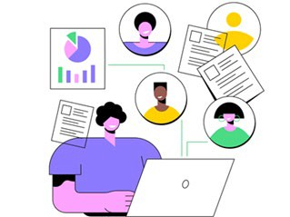
Public Sector
43
Attracting Millennials and Gen Z candidates to the public sector requires innovative recruitment strategies tailored to the preferences and values of these generations.
Emphasize Mission and Impact: Highlight the meaningful work and impact that employees can have in the public sector.
Flexible Work Arrangements: Offer flexible work arrangements, such as remote work options, flexible hours, and compressed workweeks, to accommodate the work-life balance preferences of younger generations.
Professional Development Opportunities: Emphasize opportunities for professional growth, skill-building, and career advancement within the public sector.
Embrace Technology and Innovation: Leverage technology and digital tools to modernize recruitment
Promote Diversity and Inclusion: Demonstrate a commitment to diversity and inclusion by actively recruiting and supporting candidates from diverse backgrounds and underrepresented groups.
Transparent Communication: Be transparent and authentic in communicating the benefits, challenges, and opportunities of working in the public sector
Employee Engagement and Recognition: Recognize and celebrate the contributions of employees and provide opportunities for feedback, collaboration, and recognition.

Slide 44

Public Sector
42% of Millennials/ Gen Z would rather be at a company that gives them a sense of purpose than one that pays more
44
Gen Z is on track to be the most educated generation in history, and simply completing repetitive tasks for years before a promotion or role change will cause them to leave or engage in quiet quitting
Find ways to communicate the impact of local government employees as you recruit your new generation and take the time to show your current Gen Z employees how their work positively affects the community.
A study of Gen Z’ers found that they want the opportunity to do tasks outside of what they were initially hired for, and many of them have a side gig or plan to get one.
98% of the Gen Z studies we surveyed want clear expectations from the first day on the job.
Promoting the Right Person: Promoting the right person into a leadership role requires more than just seniority or academic credentials. It involves identifying individuals who demonstrate the necessary leadership qualities, such as emotional intelligence, empathy, communication skills, and a growth mindset. Conducting thorough assessments and providing leadership competency frameworks can help ensure that the right people are selected for leadership roles.

Slide 45
Bottom Line
45
Embrace diversity of thought. Doing that well means acknowledging employees’ unique contributions to the organization’s success, regardless of their backgrounds, demographics, or titles.
Connect the dots. Successful leaders help their employees understand how their individual contribution aids the broader organizational mission and the customers or clients they serve.
Public recognition. Organizations should build employee recognition into the culture. Public praise reinforces a job well done and motivates others.
Say it again. Good managers know the importance of praising employees and telling them that their work matters. Yet few say it as often as they should, “It’s fair to say you can’t over communicate how much someone is valued,”.
Establish Organizational norms. leaders to work with employees to establish norms for how things are done and refer to them often.
Provide objective and subjective resources. To feel valued, employees need equitable compensation, with a fair salary and tangible benefits like maternity leave and health care. But they also need subjective benefits: Things like feeling appreciated, having flexible work hours, or being trusted to make decisions without being micromanaged.
Make it safe. Successful organizations create cultures where employees believe that it’s okay to express ideas, admit mistakes, and ask questions,

Slide 46
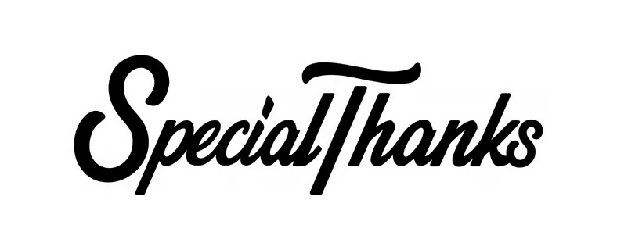
Questions?
46
NYCOM
City of Albany Department of General Services
Hon. Kathy Sheehan, Mayor
Tatiana Diaz- City of Albany Director of Human Resources
Deloitte US and our global network Research
Universum Global-Employee branding
Pew Research Center

