Slide 1

Recruitment &
Workforce Development

Slide 2
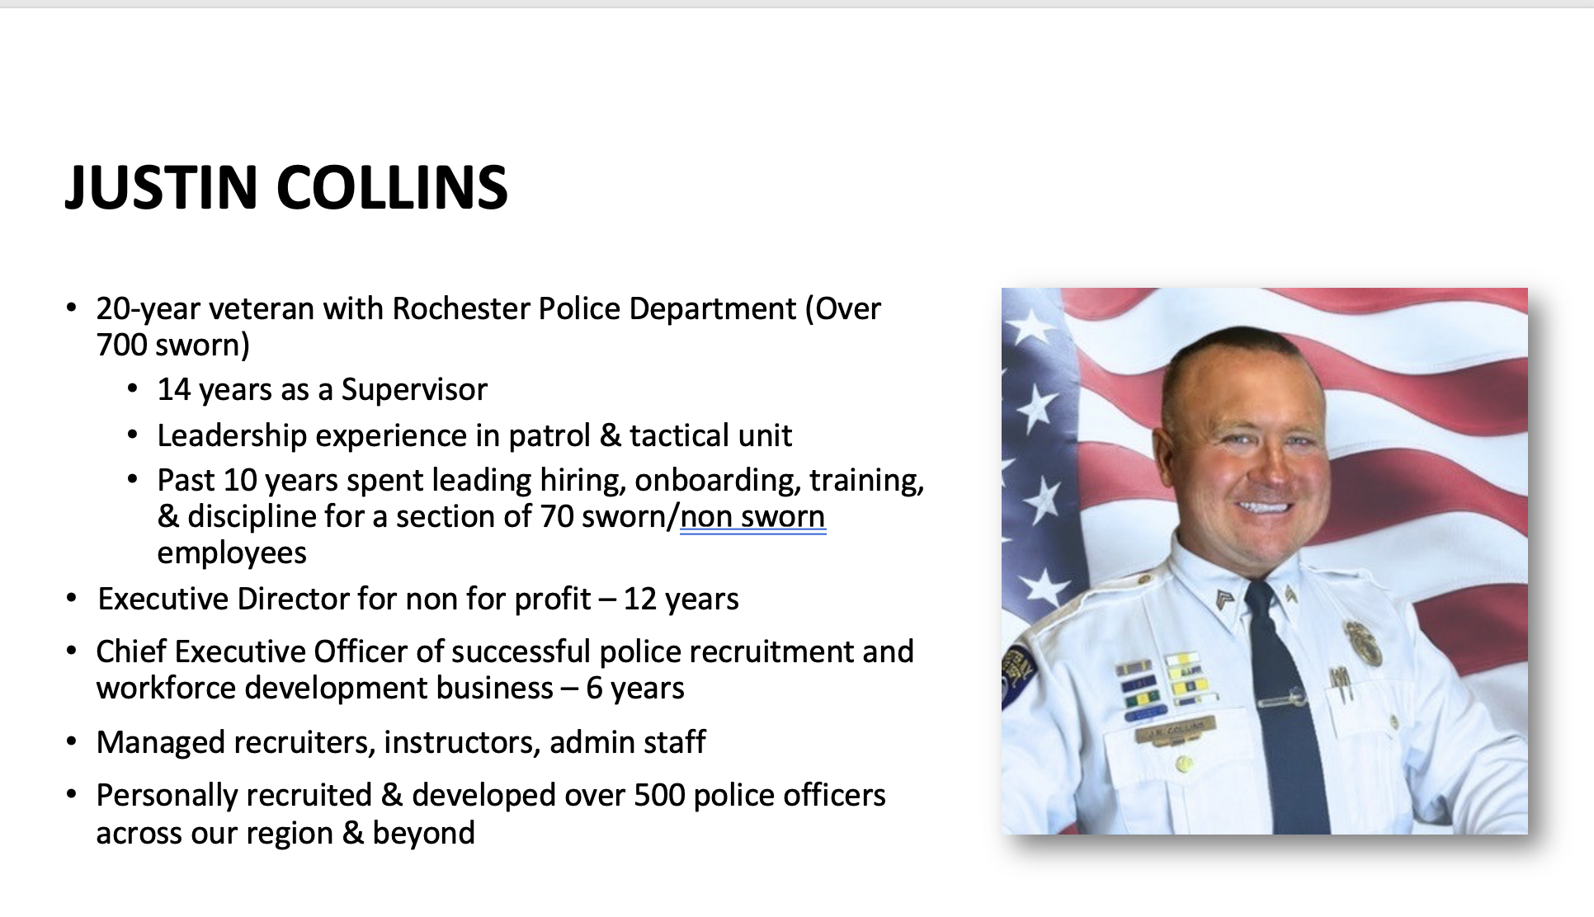

Slide 3

WORKFORCE DEVELOPMENT PROGRAM

Slide 4
WORKFORCE DEVELOPMENT PROGRAM BREAKDOWN
100% voluntary program
This not a mandatory program to be hired by RPD
No guarantee of employment as a police officer
Hybrid program
Utilize social media platform groups and in-person meetings to keep
participants accountable and engaged
Expectations are slightly below a police academy
Just enough to quickly identify serious vs. non serious candidates
Weekly community volunteer events set up for enrolled candidates
Leadership hierarchy set up within the group
Standards enforced for accountability and to provide recruiters a baseline for candidate removal

Slide 5
WORKFORCE DEVELOPMENT PROGRAM
OBJECTIVES
Build a program that provides direct line to potential RPD candidates and keeps them engaged and prepared
Create a vehicle for department /city command to show efforts to diversify
Streamline efforts to identify emotional intelligent candidates, likely to become less problematic, more impactful future RPD Officers
Develop a method to drive visibility of RPD Officers in community
Create a competitive edge in recruiting for RPD

Slide 6

WHERE DO CANDIDATES COME FROM?
Civil Service List
Referrals from police officers
Referrals from community groups
Referrals from other members of the program
Social media direct messages
Community events
Mayor’s office
Local colleges

Slide 7
WORKFORCE DEVELOPMENT PROGRAM: WHAT IT’S NOT
Explorer program or Cadet program
High school extension program
Mandatory: If you want to be a Rochester Police Officer it is not mandatory that you take part in the program
A paid internship
A community college criminal justice college collaboration program
An occasional fitness workshop held by physical agility staff

Slide 8
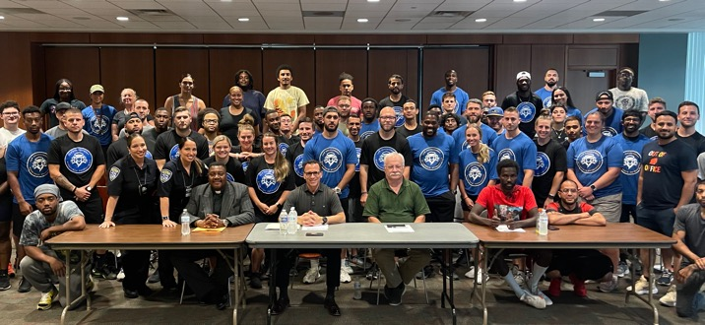
RECRUITMENT WORKSHOPS
Historically, PDS held workshops that attracted 10-15 candidates per session (2021).
With the process-driven approach that includes consistent follow up, individual outreach, and continued mentoring, the numbers has grown. 145 current candidates enrolled in the WFD program.
576.92% INCREASE

Slide 9
KEY TO SUCCESS – Investing in the Group
Recognizing leveling up and engagement concepts that exist in the 21st century
Understanding that what worked for other generations (older) does not work for this new generation
  Today's candidates want to feel like they are part of something
    Help the community
  Receive feedback from potential employers that they are on the right track
  Looking for support in accomplishing goals
Provide consistent support and feedback, personal recognition and awards

Slide 10




ROADMAP
Engage in culture
Physical Agility Prep
Resume / Interview Prep
WFD
Sign up for exam
Written Prep
Community
Engagement
Final Interview

Slide 11






FOCUS AREAS
Hyper focusing on initiatives & issues Command & community wanted addressed:
implicant bias
cultural sensitivity
public speaking
officer wellness
mental health / addiction issues
CUSTOMER
SERVICE
STAFFING
TECHNOLOGY
RELATIONSHIP
MANAGEMENT
CULTURE
LEADERSHIP

Slide 12
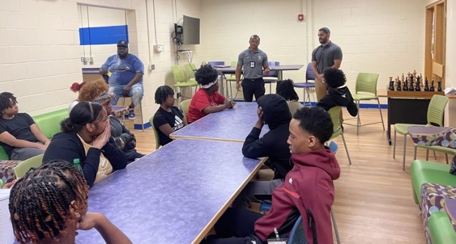
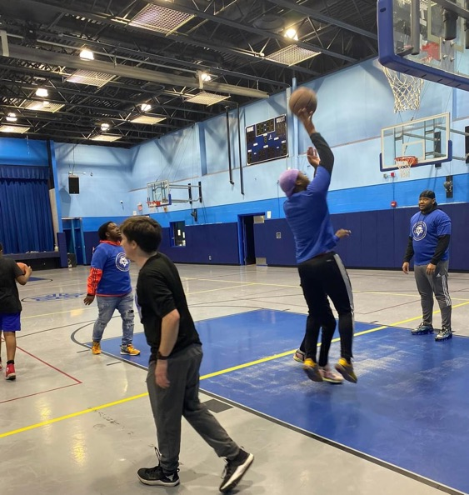
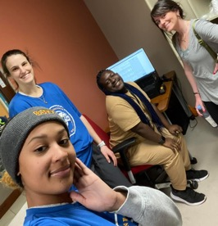
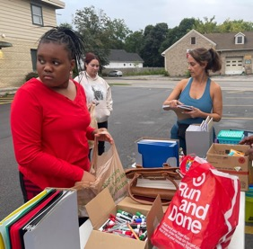
CUSTOMER SERVICE

Slide 13
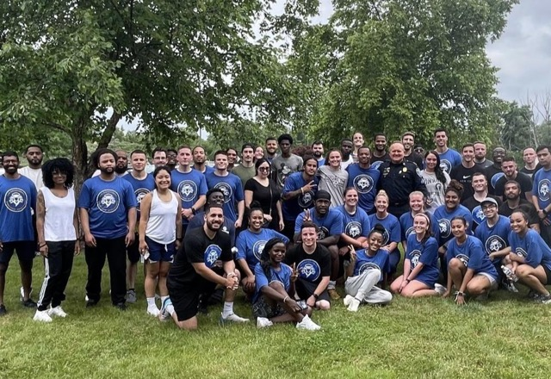
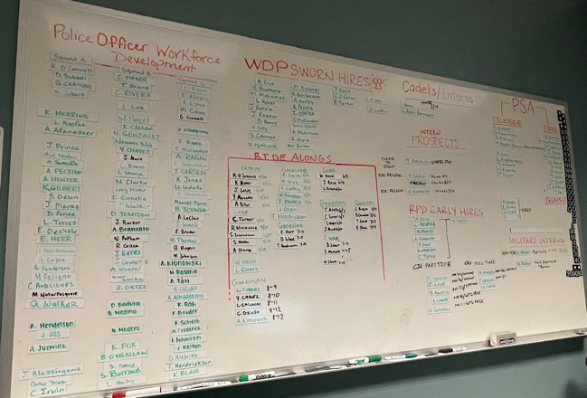
STAFFING

Slide 14
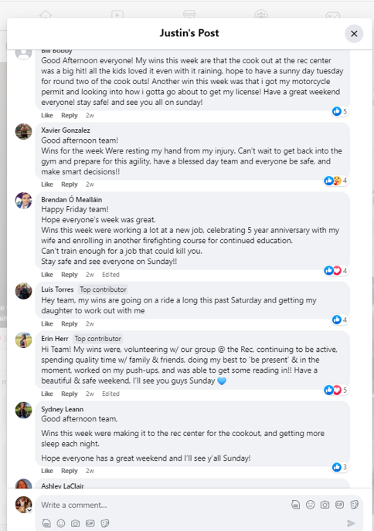
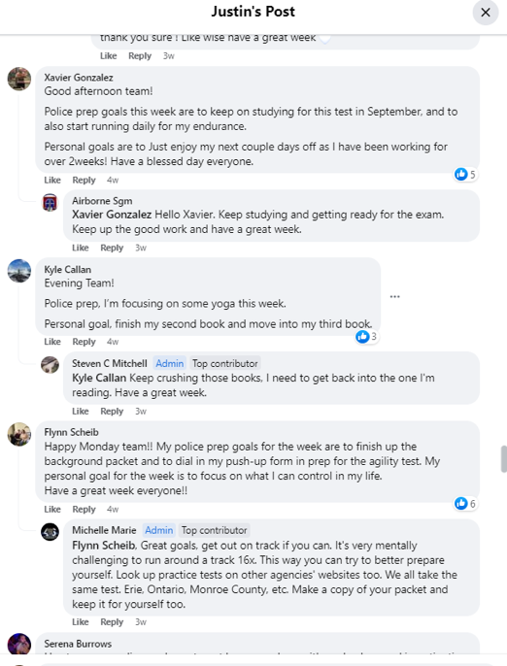
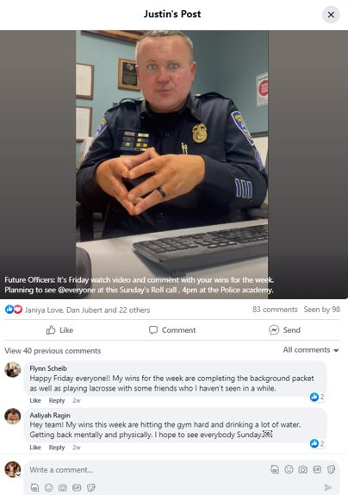
TECHNOLOGY

Slide 15
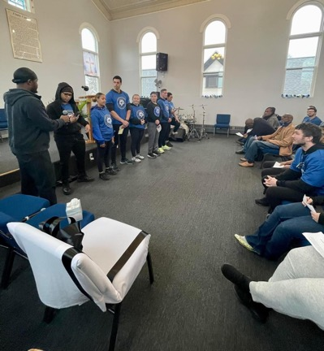
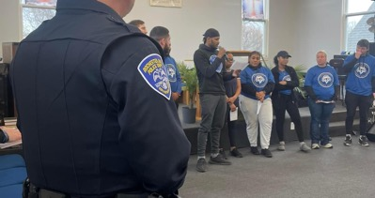
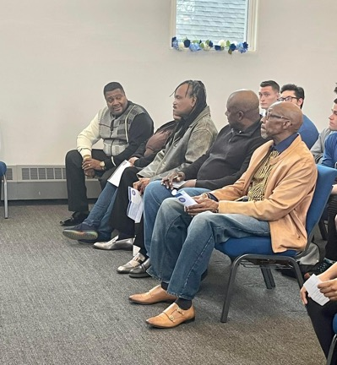
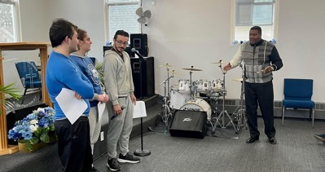
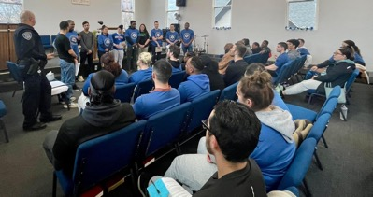
RELATIONSHIP MANAGEMENT

Slide 16
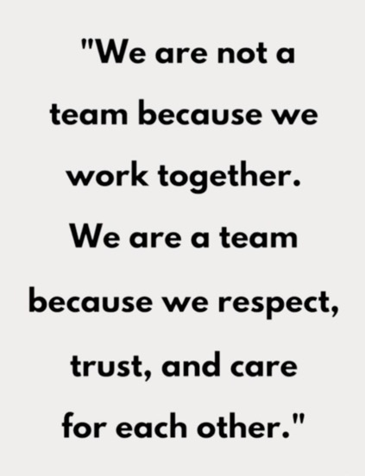

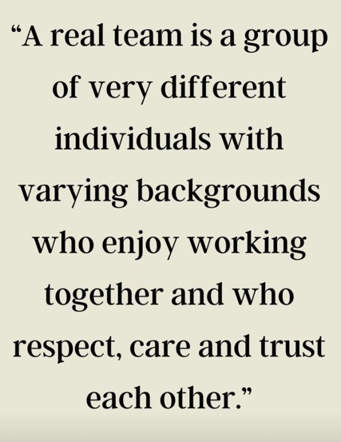
LEADERSHIP

Slide 17
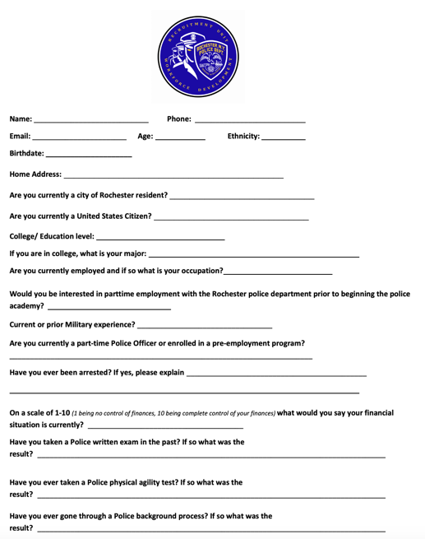
ON-BOARDING
All candidates complete an on-boarding questionnaire
Low level background
Introduction in the digital group ran on a social media platform

Slide 18
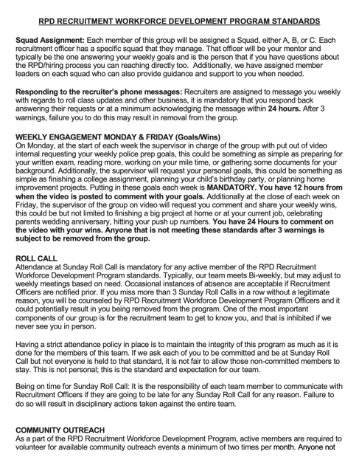
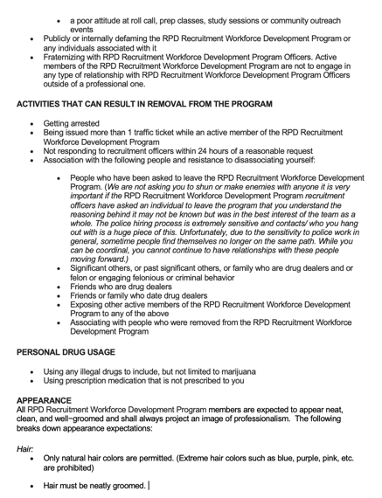
STANDARDS
Standards outline expectations for candidates who are enrolled in WFP
  Appearance
  Engagement
  Communication
  Removal from group

Slide 19
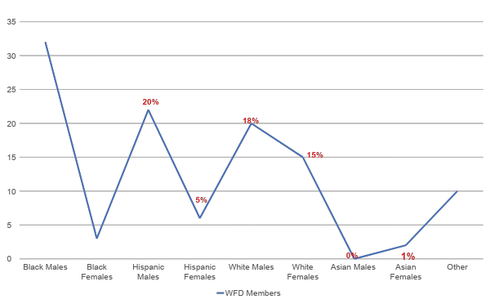
WORKFORCE DEVELOPMENT PROGRAM DIVERSITY
29%
10%
2%

Slide 20
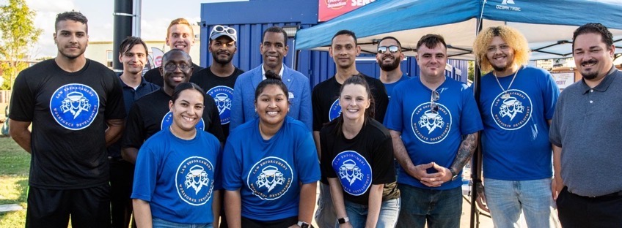
VOLUNTEERING
‘Service above self’ is the cornerstone of the WFD program
Candidates are required to volunteer in the community and engage with community members
Focused on driving engagement in the community and building relationships with community members
  To date, 3,000 hours volunteering with the children after school at
  David Gantt North Street Rec Center.
  Several thousand hours volunteered at local food pantry, homeless outreach events, reading to kids at local city schools, video game event for teens, Do the Right thing Awards, and more.
RPD Faith Link - initiative that fosters cultural understanding and community engagement by facilitating interactions between Workforce Development participants and members of various religious and cultural groups.

Slide 21

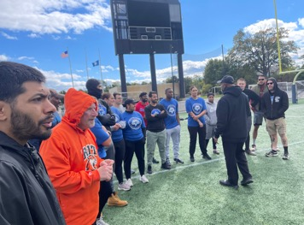

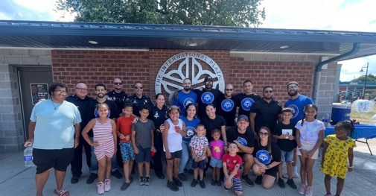
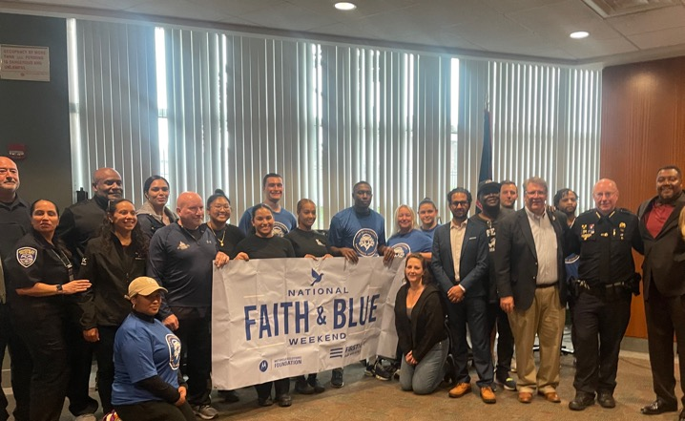
IN THE COMMUNITY
Boys & Girls Club
ROC The Peace
19th Ward Community Association
Aenon Missionary Baptist Church
Uniting & Healing Through
Hope MC
Recovery Fitness
1st Genesis Missionary
Baptist Church
Rise Up Rochester
Youth for Christ
Faith & Blue
House of Mercy
RHYBL
School 22
PrimeTime Ballers
Bridge the Gap

Slide 22
RIDE ALONGS

Slide 23
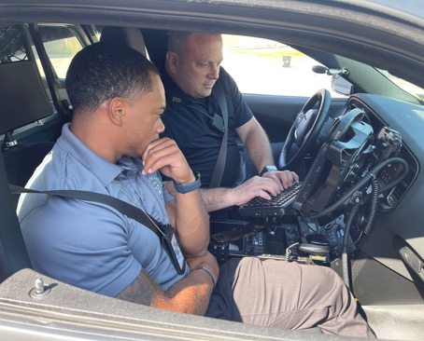
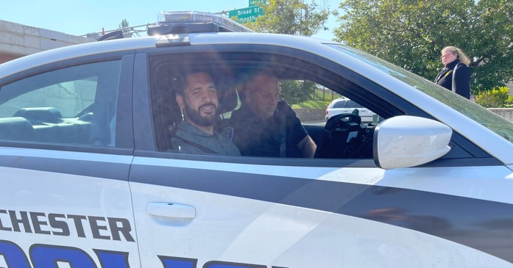
RIDE ALONG PROGRAM
80 Ride Alongs between March 2023 - May 2024
Engaged 4 sections & over 30 officers
Benefit we offer to members of the WFD
Not offered to all WFD members
Strict qualifications for participation

Slide 24

ADDITIONAL PIPELINE CREATING PROGRAMS THAT DRIVE DIVERSITY

Slide 25

KEY TO SUCCESS – Collaboration with Human Resources
Waiving the entrance exam fee
Continuous Enrollment: test registration portal opened to accepting applicants 24/7/365
Opened part time positions for recruiting
  Utilized part time civil positions as recruitment tool
Consistent communication
  Recruitment Unit management and HR professionals met regularly to stay on the same page
Early engagement in exam registration list
  HR provides Recruitment Unit with monthly updates of new candidates for recruiters to follow up with
  In the past folks signed up for the test and wouldn’t hear back for 6 month

Slide 26


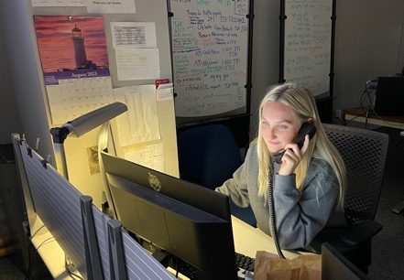
EARLY HIRE PROGRAM
Pipeline for civilian positions - mutually beneficial relationship between WDP candidates and TSS
Provides an opportunity to employ Workforce Development Program candidates in civilian roles within the department, ensuring their immersion in department culture and enhancing retention before they are given consideration as a sworn officer.
100% diversity
We have 14 early hires - 5 of which have graduated the program
  4 sworn RPD Officers & 1 RFD

Slide 27



Service to Shield Program
Partnership between the US Military and RPD
Designed for military veterans transitioning to civilian life.
Program offers opportunities to explore careers within the RPD.
Internship paid for US military through Skill Bridge program. One Person enrolled who was offered a position by NYSP before we could offer him.

Slide 28

RPD FUTURE FORCE COLLEGE INTERNSHIP PROGRAM
Providing valuable hands-on experience, this program prepares interns for potential enrollment in the Early Hire Program, contributing to a diverse and skilled workforce. We currently have 4 interns as part of the Future Force Public Safety Intern program, boasting a 100% minority enrollment rate.
Program Success - Hires
9 Future Force interns
3 offered jobs as civilians when internship was complete
One hired as a sworn Rochester Police Officer.

Slide 29

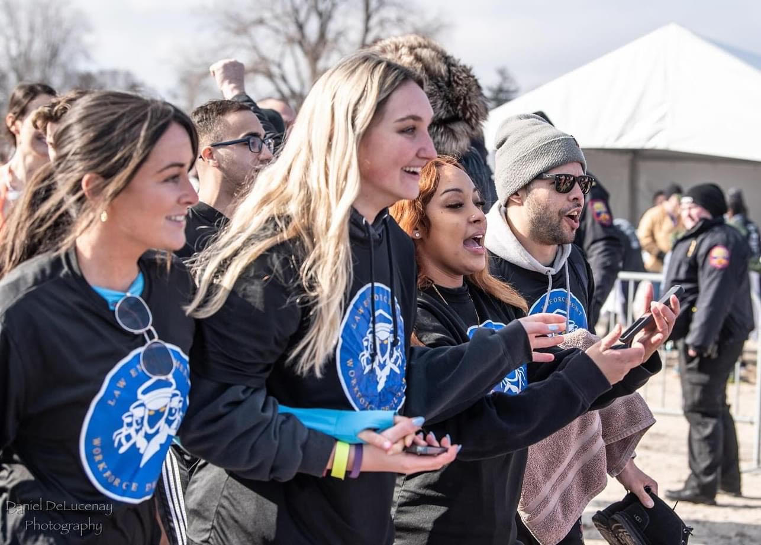
RPD EMPOWER 30

Slide 30
RESULTS

Slide 31


ENGAGEMENT AT THE POLICE EXAM
90% of WDP members showed up for Physical Agility Test
95% attendance rate for WDP members for last written police exam
60% passing rate for WDP members
Over 65 WDP members currently in background process waiting for
selection results

Slide 32
55 HIRES
from WDP to date
(Combined hires to RPD & surrounding agencies)
Notes:
29 TO RPD

Slide 33
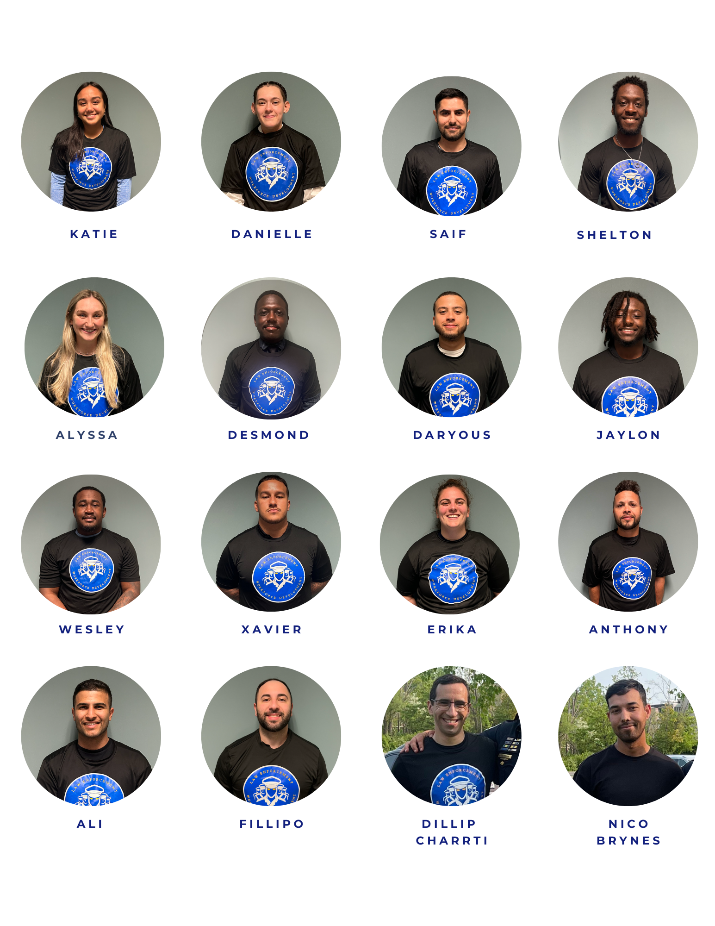
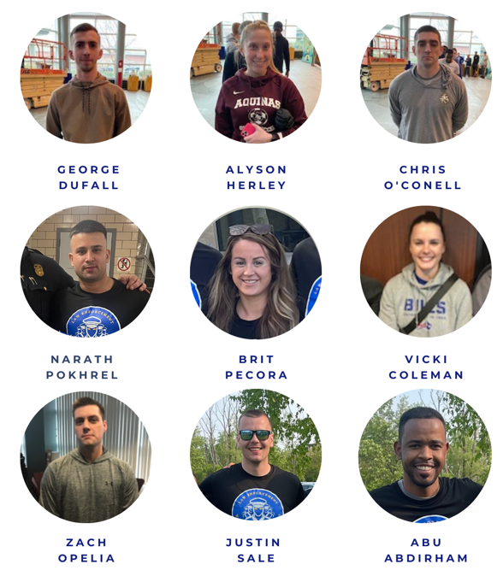
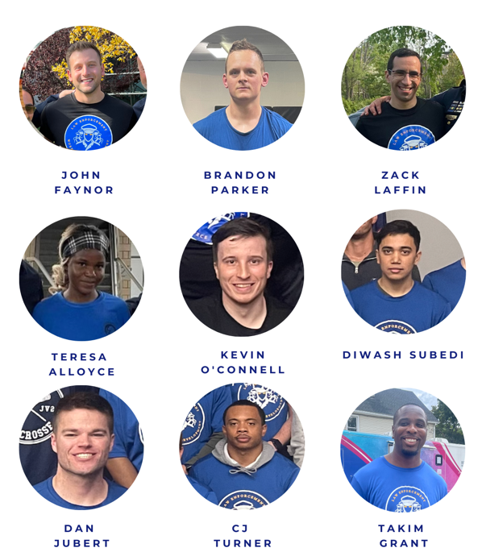
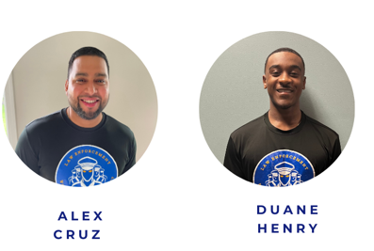
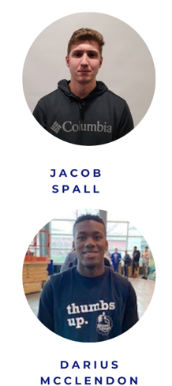
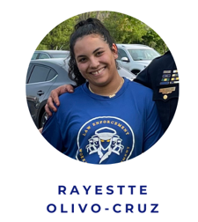
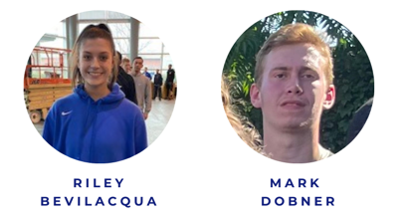
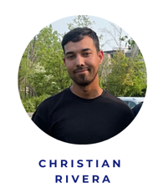
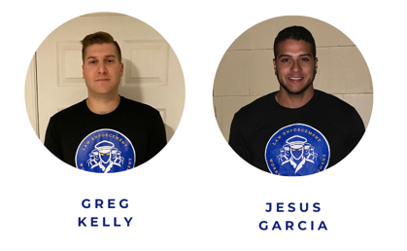
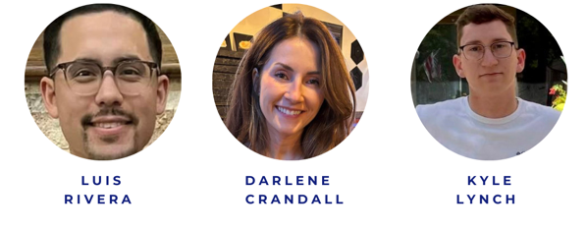
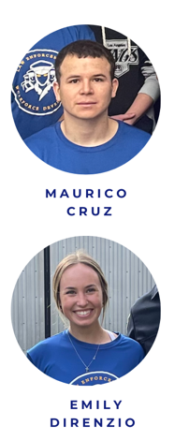
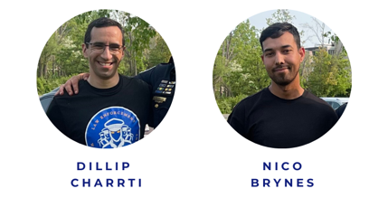
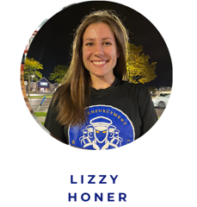

WDP HIRES - 80% of Hires Minority

Slide 34
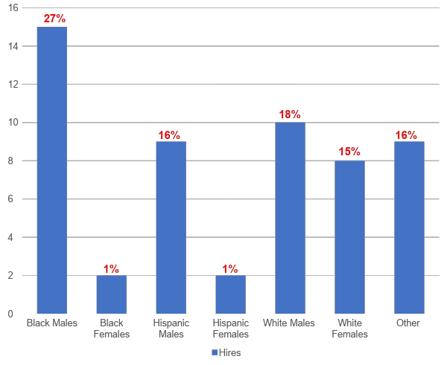
WDP SWORN HIRE
DIVERSITY

Slide 35





HISTORIC FIRSTS
Nepal X3
Yemen
Congo
Somalia
Honduras

Slide 36
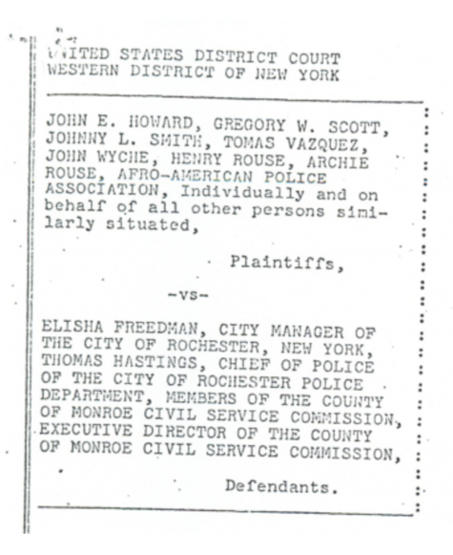
RECOGNITION FOR THE PROGRAM
WDP added to City of Rochester Decent Decree
Result of Howard vs Freeman, City of Rochester Decent Decree was put in place to create & enforce a road map for RPD hiring practices
RPD should maintain a workforce of 25% minority officers & ensure there are measures to support this

Slide 37
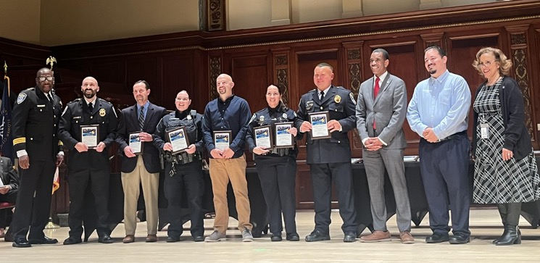


RECOGNIZED BY THE CITY OF ROCHESTER WITH INNOVATION AWARD

Slide 38
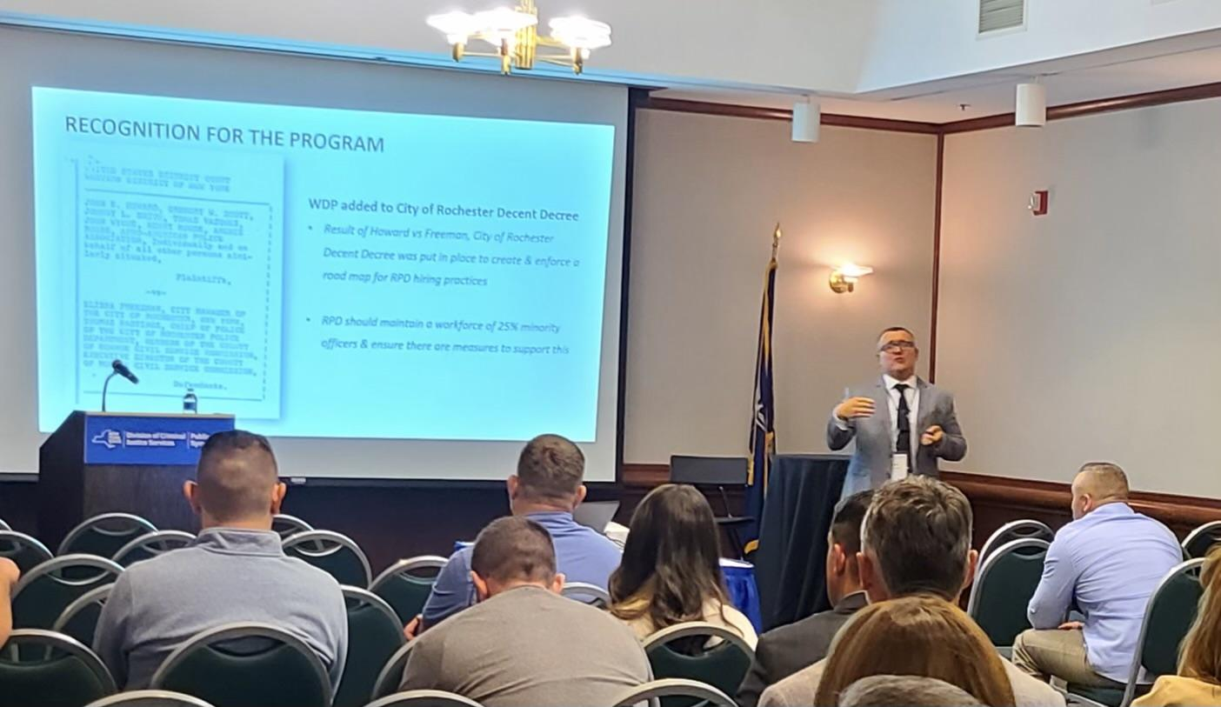

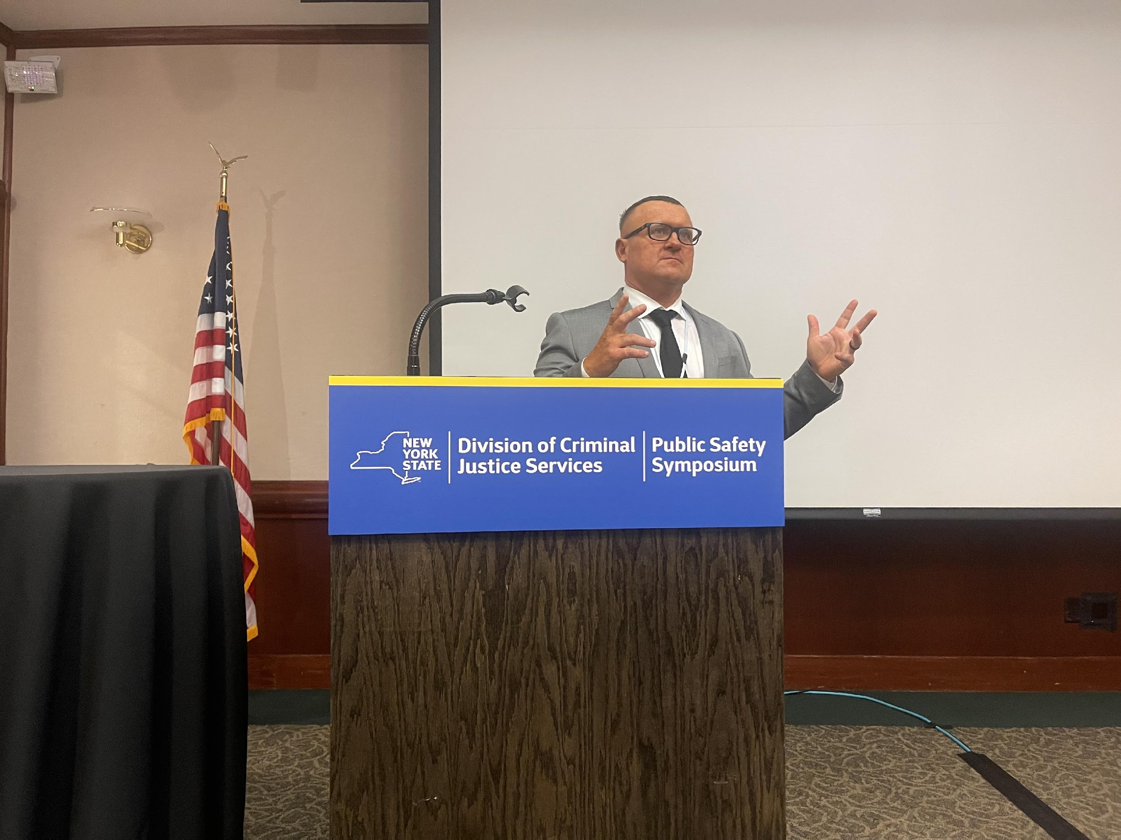
DCJS ENGAGEMENTS
Presented at 2023 Symposium
NOW LIVE: DCJS added Workforce Development Program to Knowledge Bank

Slide 39
WHERE WORKFORCE DEVELOPMENT IS HEADED
Developing future department/community leaders
Higher quality candidate who is more emotionally intelligent and ready to work
True understanding of department culture
Deep engagement in the community
Cut down on complaints & internal issues

Slide 40










ALL ROADS LEAD TO
WORKFORCE DEVELOPMENT
15-18 yrs old
15-18 yrs old
10-17 yrs old
7-17 yrs old

Slide 41


Slide 42
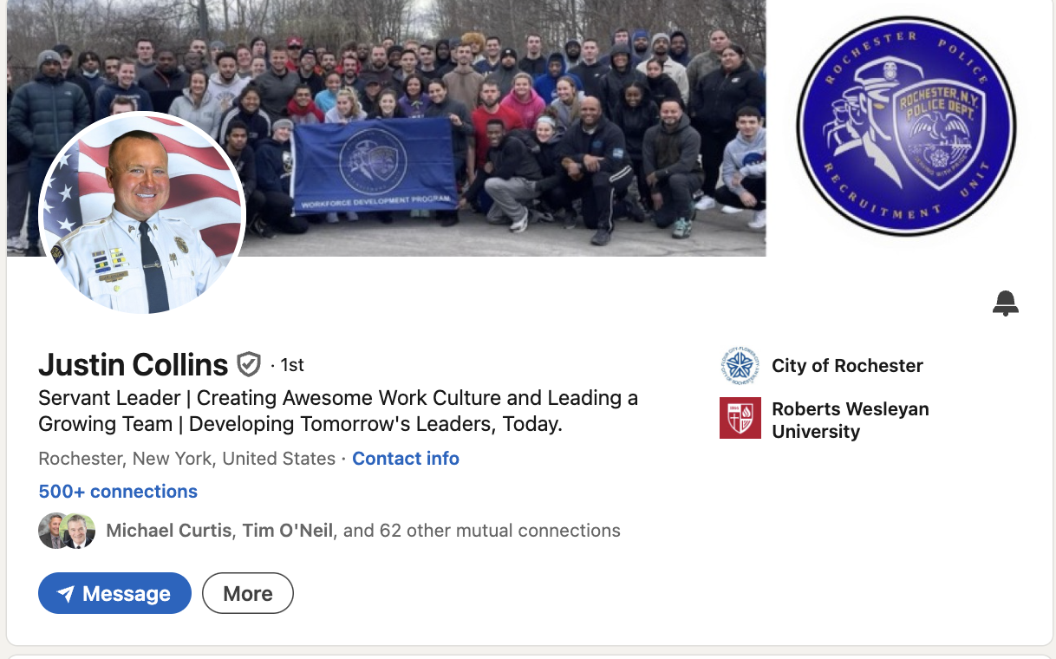
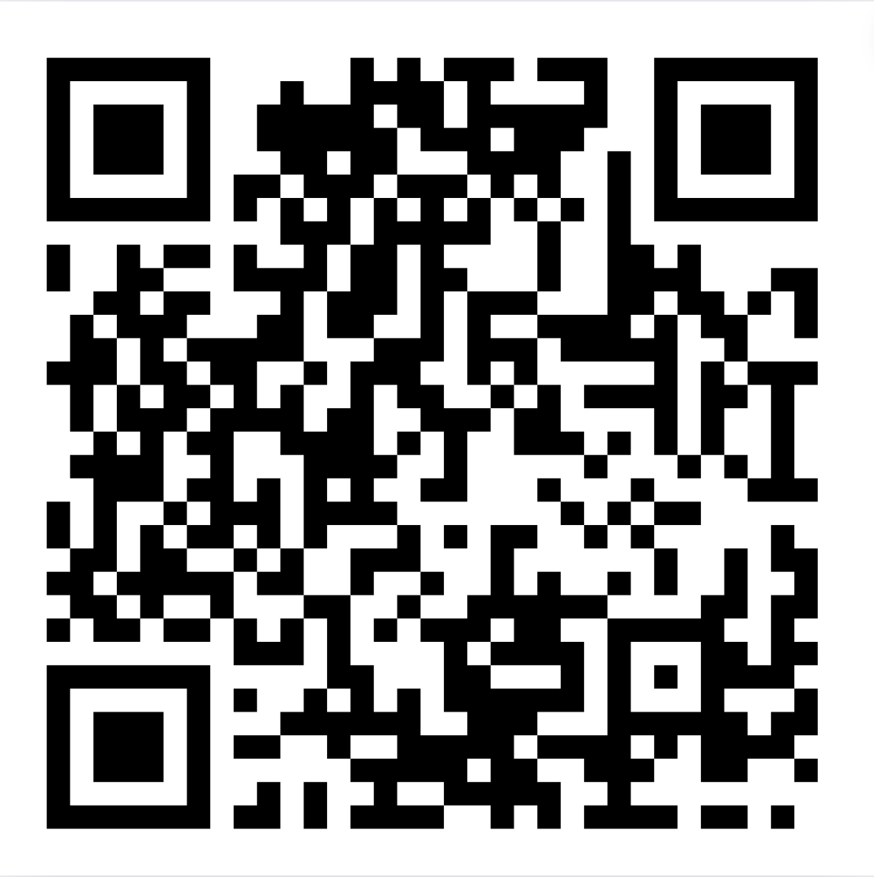
Connect with me!

