Slide 1





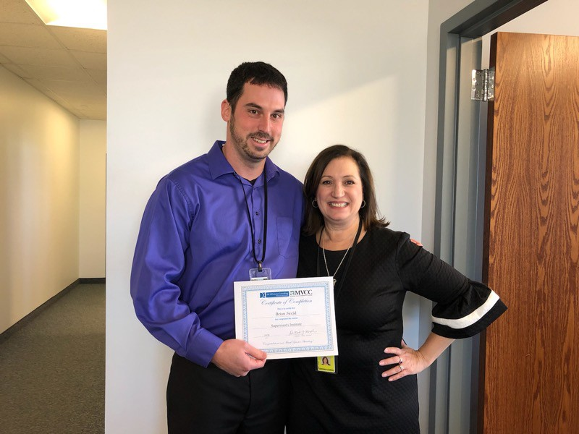


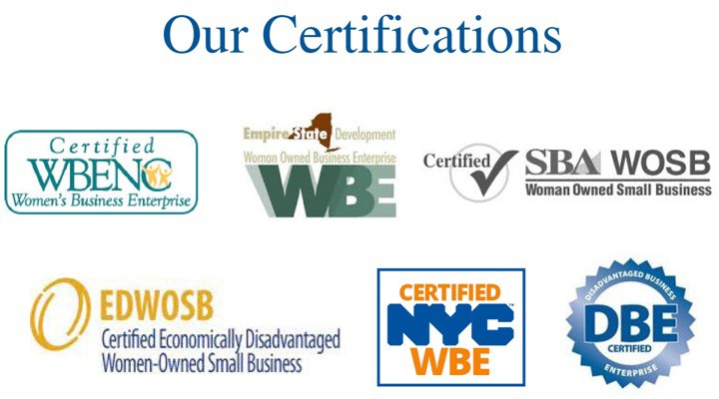
Exciting Things are Coming to Civil Service!
Driving and Embracing Change with a Positive Mindset
Deborah J Cabral, PCC Founder/President & CEO
Learning & Development Strategist & Trainer/Facilitator, Leadership & Team Coach, Productivity & Efficiency Consultant
1
2
3

Slide 2



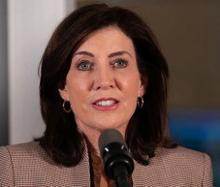
What we’ll learn today:
NYS Civil Service Exciting News!
Kotter’s 8 Step Accelerators for Change
Change is VUCA!
Engaging/Leading in a VUCA Environment
Strategies for Leading Effectively Through Change with a Positive Mindset
Positive Mindset Strategies
SWOT Analysis Exercise
Agenda
4
How are you feeling this morning?
ⓘ Start presenting to display the poll results on this slide.
5
NYS Civil Service- Exciting News!!
The New York State Department of Civil Service is working to transform the merit system for state and local agencies and job seekers.
The Department is undertaking this transformation as a result of Governor Kathy Hochul’s commitment to modernize and streamline government operations to make government work better for all New Yorkers.
In order for this transformation to be successful, it will require the input and buy-in of all relevant stakeholders throughout the process. You are all stakeholders!
Modernization means change, which for some can be difficult.
6

Slide 3

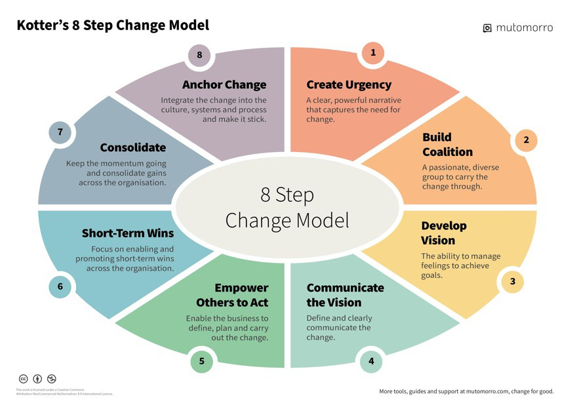
Why is change at work so difficult?
ⓘ Start presenting to display the poll results on this slide.
7
8
Change is VUCA!
9

Slide 4
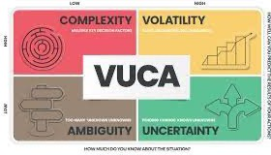


What is VUCA?
VUCA is an acronym that
stands for volatility, uncertainty, complexity
and ambiguity -- qualities that make a situation or condition difficult to
analyze, respond to or plan for.
Volatile – change is rapid, significant and
unpredictable in its nature and extent.
Uncertain – the present is unclear, and
outcomes and events are unpredictable.
Complex – many different, interconnected factors come into play, with the potential to cause chaos and confusion.
Ambiguous – there is a lack of clarity or awareness about the situation.
10
What can a VUCA Environment Do?
Destabilizes people and makes them anxious.
Saps their motivation.
Makes constant retraining a necessity.
Takes huge amounts of time and effort to fight.
Increases the chances of people making bad decisions.
Paralyzes decision-making processes.
Jeopardizes long-term projects, developments and innovations.
Overwhelms individuals and organizations.
Takes its toll on internal culture.
"Bleeds" inwards and creates VUCA environments within organizational teams.
11
What does the acronym VUCA mean?
ⓘ Start presenting to display the poll results on this slide.
12

Slide 5



Engaging/Leading in a VUCA Environment with Positivity
Counter Volatility With Vision
Accept and embrace change as a constant, and an unpredictable feature of your working environment. Don't resist it!
Create a strong, compelling statement of team objectives and values, and develop a clear, shared vision of the future.
Make team goals flexible so they can be amended, when necessary. This allows teams to navigate unsettled, unfamiliar situations, and react quickly to changes.
13
Engaging/Leading in a VUCA Environment with Positivity
Meet Uncertainty With Understanding
Pause to listen. This can help you understand and develop new ways of thinking and acting.
Make investing in, analyzing and interpreting your work a priority, so that you don't fall behind. Stay up to date and listen carefully to your
employees to find out what they know or need.
Review and evaluate your performance. Consider what you did well and what you could do differently next time.
Simulate and experiment with situations, so that you can explore how they might play out, and how you might react to them in the future. Aim to anticipate possible future challenges and how you can respond to them.
14
Engaging/Leading in a VUCA Environment with Positivity
React to Complexity With Clarity
Communicate clearly and often with all employees.
Develop teams and promote collaboration. VUCA situations are often too complicated for one person to handle. So, build teams that can work effectively in a fast-paced, unpredictable environment.
15

Slide 6


Engaging/Leading in a VUCA Environment with Positivity
Fight Ambiguity With Agility
Promote flexibility, adaptability and agility. Plan ahead. Build in contingency time and be prepared to alter plans if necessary.
Hire, develop and promote people who thrive in VUCA environments. These people are likely collaborative, comfortable with ambiguity and change, and have
complex thinking skills.
Encourage employees to think and work outside of their
usual functional areas, to increase their knowledge and experience. Job rotation and cross training can be excellent ways to improve team agility.
16
Engaging/Leading in a VUCA Environment with Positivity
Fight Ambiguity With Agility
Lead your team members, but don't dictate to or control them.
Develop a collaborative environment, and work hard to build and gain buy in. Encourage debate, dissent and participation from everyone.
Embrace a culture of ideas! Acknowledge and reward team members who demonstrate vision, understanding, clarity, and agility. Let employees see what kind of behavior you
value by highlighting innovation and calculated risk taking.
17
Where is your organization currently as it relates to VUCA?
ⓘ Start presenting to display the poll results on this slide.
18

Slide 7


Strategies for Leading Effectively Through Change with a Positive Mindset
19
Strategies for Leading Effectively Through Change with a Positive Mindset
Establish and Share the Agency’s Core Values such as trust, transparency, honesty with ALL employees.
Create a Culture of Psychological Safety. This means that
employee feel safe and comfortable asking questions and have no fear disagreeing. For people to feel psychological safety, they must have trust, respect, and honesty from their leaders.
Create a Collaborative Culture. No person on a team is superior or inferior to anyone else. We are all people regardless of our titles. Everyone should have a voice. Work together collaboratively,
rather than in silos.
20
Strategies for Leading Effectively Through Change with a Positive Mindset
Make Employees Feel Valued, Appreciated and Heard. Listen with the intent to understand, and learn rather than reply or debate! Build healthy relationships with teams and
employees.
Communicate with ALL Employees OFTEN
Keep employees informed on progress of benchmarks, milestones and successes.
Be Flexible, Agile, Open Minded and Have Personal Accountability
Be able to move quickly and easily when necessary. Do what you say and say what you do.
21

Slide 8

Strategies for Leading Effectively Through Change with a Positive Mindset
Cultivate Relationship intelligence.
Establish strong working relationships.
Have a positive regard and be service oriented.
See employee’s strengths, rather than challenge areas.
Utilize Two-Sided Contracts What am I going to do to? What are you going to do?
Clarify all expectations.
22
How else can leaders lead through change with a positive mindset?
ⓘ Start presenting to display the poll results on this slide.
23
Positive Mindset Strategies
24

Slide 9



Positive Mindset Strategies
Engage in positive self talk.
Practice gratitude.
Spend time with positive people.
Remember to laugh.
Practice mindfulness.
Avoid or reframe negative language.
25
Positive Mindset Strategies
Celebrate small wins.
Repeat positive affirmations.
Take a break!
Seek support when needed.
Reflect on positive experiences.
26
Which character are you on the positivity scale?
ⓘ Start presenting to display the poll results on this slide.
27

Slide 10
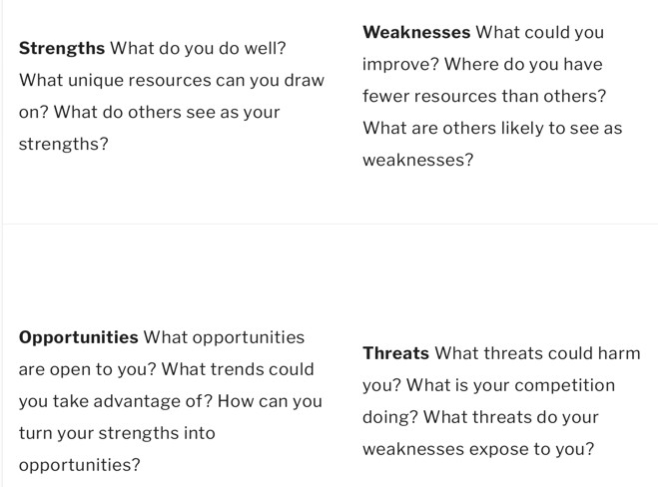
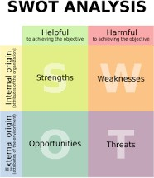
SWOT Analysis
28
What is a SWOT Analysis?
SWOT stands for Strengths, Weaknesses, Opportunities, and Threats. A SWOT analysis is a technique for assessing these four aspects of any problem and its potential solutions.
SWOT Analysis is a tool that can help you to analyze what your organization does best now, and to devise a successful strategy for the future.
A SWOT analysis examines both internal and external factors – that is, what's going on inside and outside your organization. So, some of these factors will be within your control and some will not. In either case, the
wisest action you can take in response will become clearer once you've discovered, recorded and analyzed as many factors as you can.
29
What is a SWOT Analysis?
30

Slide 11

Have you ever conducted a SWOT Analysis?
ⓘ Start presenting to display the poll results on this slide.
31
It’s time for an Individual Exercise, then Group Share with the DCS Team!
32
Let’s Conduct A SWOT Analysis
Please complete a SWOT Analysis of NYS’s current Merit System and share your ideas with colleagues and members of the NYS Department of Civil Service Team.
33

Slide 12


Let’s Conduct A SWOT Analysis of the Current
Civil Service Merit System.
Team SWOT Analysis Exercise
Using a real life or potential problem that you may experience with your team, determine a solution to the problem using the SWOT (Strengths, Weaknesses, Opportunities and Threats) analysis.
List the problem: Gaining Buy-in on the Civil Service Merit System Modernization Process
List the potential solution: 4IBSF :PVS *EFBT XJUI .FNCFST PG UIF /:4 %FQBSUNFOU PG $JWJM 4FSWJDF
Analyze the solution using SWOT analysis:
Strengths | Weaknesses
Opportunities | Threats
34
(315) 794-9495 • dcabral@DCeffconsult.com • www.DCeffconsult.com
©2018 The DeClutter Coach & DC Efficiency Consulting are divisions of Cabral Enterprises, LLC.
All rights reserved. Duplication of any or all information contained in this hand out is strictly prohibited.
Team SWOT Analysis Exercise
Using a real life or potential problem that you may experience with your team, determine a solution to the problem using the SWOT (Strengths, Weaknesses, Opportunities and Threats) analysis.
List the problem: Gaining Buy-in on the Civil Service Merit System Modernization Process
List the potential solution: 4IBSF :PVS *EFBT XJUI .FNCFST PG UIF /:4 %FQBSUNFOU PG $JWJM 4FSWJDF
Analyze the solution using SWOT analysis:
Let’s Debrief!
Strengths | Weaknesses
Opportunities | Threats
35
(315) 794-9495 • dcabral@DCeffconsult.com • www.DCeffconsult.com
©2018 The DeClutter Coach & DC Efficiency Consulting are divisions of Cabral Enterprises, LLC.
All rights reserved. Duplication of any or all information contained in this hand out is strictly prohibited.
What we learned today:
NYS Civil Service Exciting News!
Kotter’s 8 Step Accelerators for Change
Change is VUCA!
Engaging/Leading in a VUCA Environment
Strategies for Leading Effectively Through Change with a Positive Mindset
Positive Mindset Strategies
SWOT Analysis Exercise
Agenda
36

Slide 13



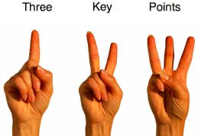
What questions do you have?
37
How ready are you to effectively drive and manage change with a positive mindset in your organization?
ⓘ Start presenting to display the poll results on this slide.
38
Now What?
What 3 points are you committed to implementing RIGHT AWAY?
39

Slide 14

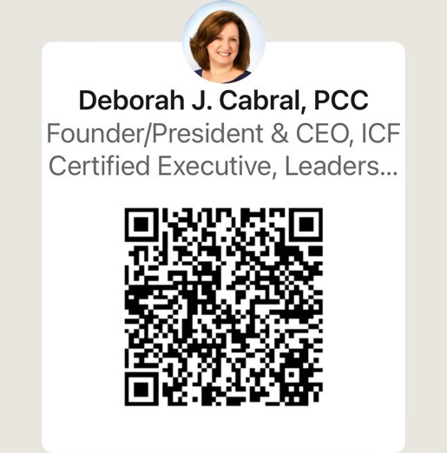

40
Please connect with me!
41

