Slide 1

Persons with Disabilities: An Untapped Resource

Slide 2

"Begin with the end in mind"-Dr. Stephen R. Covey
Demystify physical disabilities
Inform on the realities of disabled employment
Bust some myths on disabled employment
Provide some actionable things you can do now
Tell some cool stories

Slide 3

My Story

Slide 4
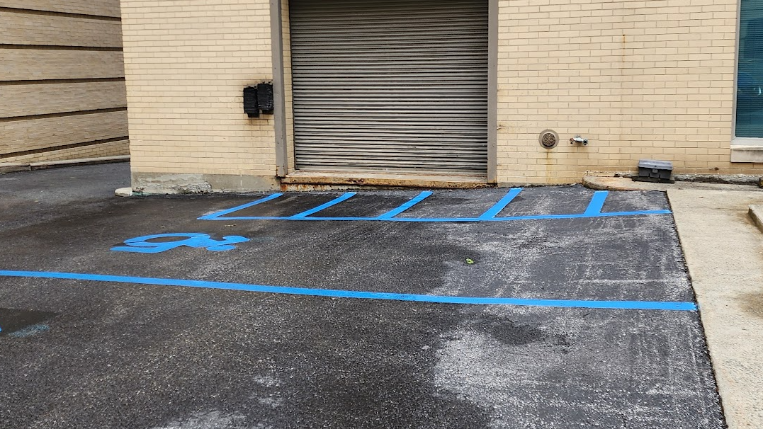
My Parking Spot

Slide 5
My Story

Slide 6
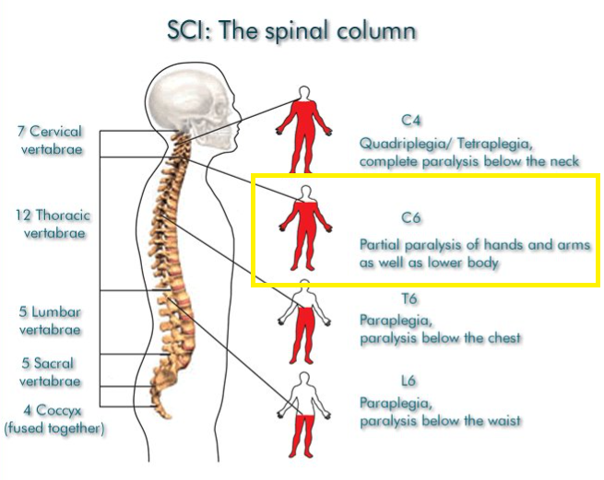
My Story (Injury)

Slide 7

My Story
Highschool
ACCES VR
Siena
Law

Slide 8
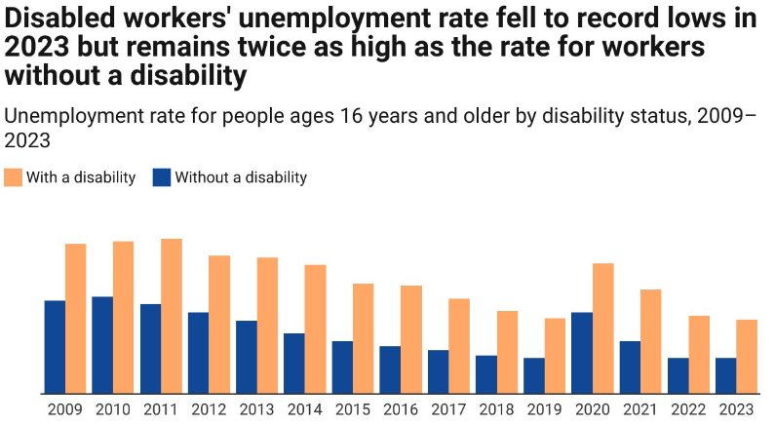
Realities of Disabled Employment

Slide 9
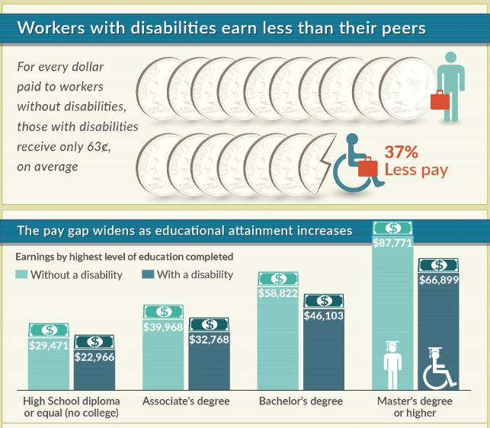
Realities of Disabled Employment

Slide 10

Realities of Disabled Employment
NBER (National Bureau of Economic Research)
Study: A field experiment involving 6,016 job applications for accounting positions using fictional resumes.
Experiment Design:
  One-third of applications disclosed a spinal cord injury.
  One-third disclosed Asperger’s Syndrome.
  One-third did not mention any disability.
  Disabilities chosen were unlikely to affect accounting productivity.
Key Finding:
  Applications from individuals with disabilities received 26% fewer employer responses compared to those without disabilities.
  State laws showed no clear effect.

Slide 11
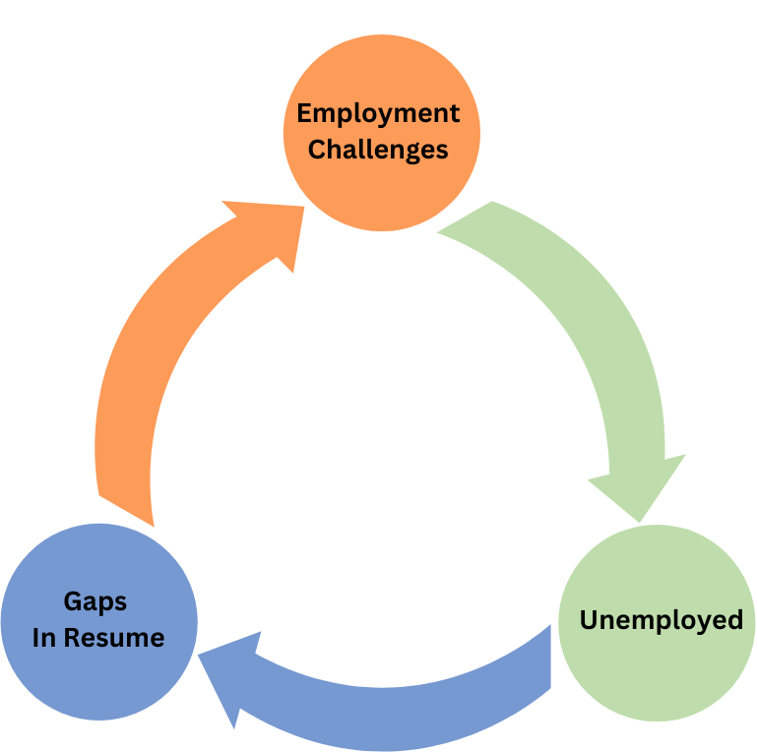
Realities of Disabled Employment

Slide 12


Realities of Disabled Employment
"You will have to prove to everyone your more than your disability"
"The best we can hope for Michael is he can be a manager at an HQ"

Slide 13

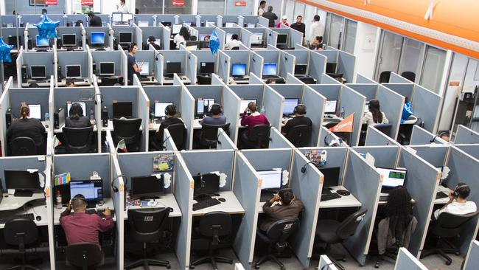
Realities of Disabled Employment
"Our meeting room is on the second floor; how will you manage that"
"Our office is pretty packed do you think it will cause a disruption"

Slide 14
Myths About Hiring Persons With Disabilities
They call in sick all the time
The reasonable accommodations will cost a ton
They cannot do the job
They will leave sooner and not worth the investment

Slide 15
Myth Busting (Calling in Sick)
Connelly Research
Study: A food services company that runs hospital cafeterias and university food courts.​
Key Finding:​
    Average annual absences: Employees with disabilities averaged 3 days, significantly less than the 6.5 days observed among their non-disabled counterparts.
    Employees with disabilities demonstrated significantly lower absence rates.

Slide 16
Myth Busting (Reasonable Accommodations)
Job Accommodation Network (JAN)
Study: Information from 4,447 employer surveys completed between January 1, 2019 and December 31, 2023.
Key Finding:
56% report no cost for accommodations.
    37% faced a one-time cost, median of $300.
    7% incurred ongoing costs, median annual cost of $1,925.
    Positive outcomes include retaining valuable employees and enhancing productivity.

Slide 17
Myth Busting (Reasonable Accommodations)
Modifying Work Sites
Accessible Facilities
Providing Readers
Flexi-Time
Flexi-Place
Modifying Work Schedules
Assistive Devices

Slide 18
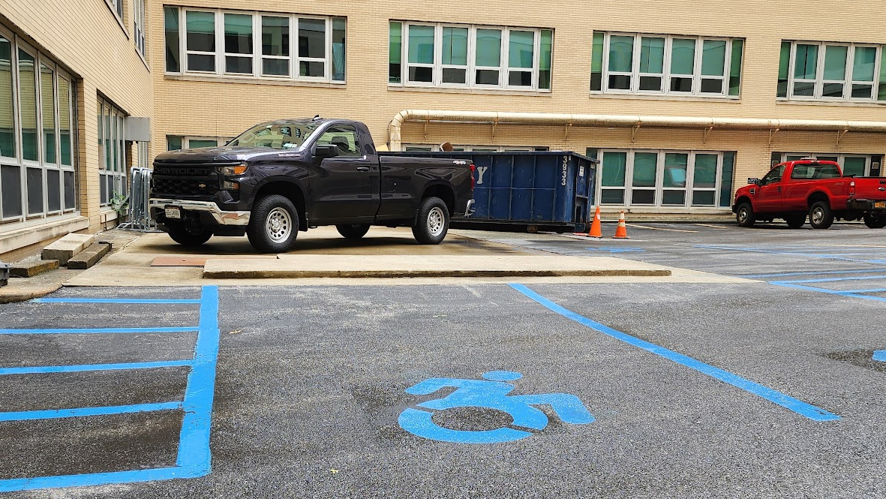
My Parking Spot

Slide 19
Myth busting (Job Performance)
DuPont and VCURRTC National Research Study
Study: Survey of 811 employees with disabilities.
Key Finding:​
90% rated average or better in job performance
    Employees with disabilities are as capable and productive (timeliness, punctuality, task consistency & work speed)

Slide 20
Myth busting (Employee Loyalty)
Disabled World, 2009
Study: Pizza Hut “Jobs Plus Program” over 4,000 participants, and over two-thirds of them having a disability.
Key Finding: The turnover rate among people with disabilities is much lower, just 20%, compared to their non-disabled coworkers who have a turnover rate of 150%

Slide 21

What Causes These Myths
Misconceptions
Fear of the unknown
I tell my story to try and demystify circumstance
I am open with my life experiences
Sometimes maybe too open

Slide 22




Reasons I am in a wheelchair (According to my Kids)

Slide 23
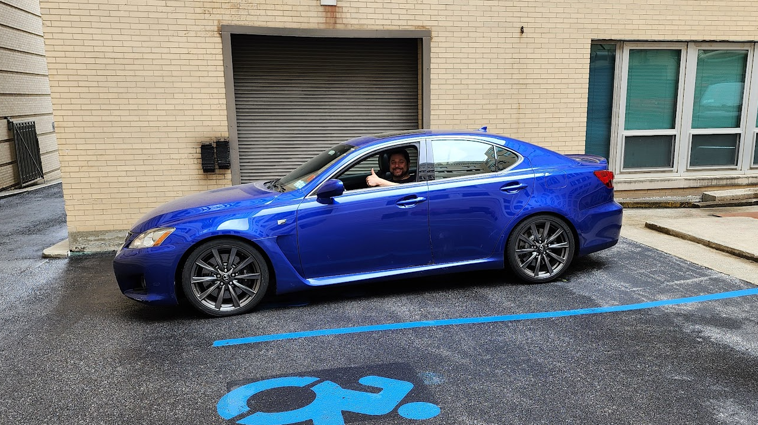
Reasons I am in a wheelchair (According to my Kids)

Slide 24


Myth Busting (My Experience)
Resilience
Planning/Preparation and Time Management

Slide 25
Why would you NOT hire someone with a disability
We call in sick less
The cost to enable us to do the job is minimal
We meet and exceed performance standards
We are on average are more loyal to our employer

Slide 26

Shanidar Cave
Discovered in the mid-1950
10 Neanderthal remains
50,000 years old

Slide 27

Shanidar Cave
One of the most important discoveries
Points, side-scrapers, and flakes
Bones from animals including wild goats and spur-thighed tortoises.

Slide 28
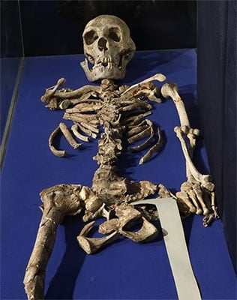
Shanidar 1 (Nandy)
Crushing blow to head
Blind in one eye
Right Side Paralysis
Deaf in one ear
Arm Amputation
Many other injuries

Slide 29
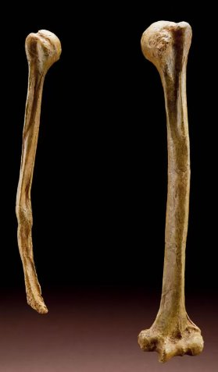
Shanidar 1 (Nandy)
All injuries showed signs of healing
Amputated right arm
Lived to be 35-45
Provided Cultural Knowledge

Slide 30

What can you do to attract us
Include inclusive language in your job postings
[ORG]values the differences of all current and prospective employees and recognizes how every employee contributes to our company's success. [ORG] provides reasonable accommodations in job application procedures for individuals with disabilities. If you require assistance due to a disability in the application or recruitment process, please submit a request via email at recruitingaccomodations@[ORG].com or via telephone at +1 555 555 5555
Look through your office from a different perspective
Review your training to ensure disability is accounted for
Leverage Civil Service as a resource
Acces- VR Business Relations Team

Slide 31

Section 55-a
Overview: Section 55-a of the Civil Service Law allows municipalities to appoint persons with disabilities to certain non-competitive positions.
Municipal civil service commissions can designate up to 700 such positions.
These positions are for physically or mentally disabled persons who are qualified to perform the duties satisfactorily.
At least 300 positions are reserved for physically disabled persons.
As of the end of last year 381positions have been filled.

Slide 32

Questions? Conversation?

