Slide 1
Getting to Yes!
Rules Resolutions & Appendices Changes
Jason Laird & Anthony Rotundo
Tuesday, June 11, 2024, 1:15 p.m.

Slide 2
Getting to Yes! Rules Resolutions & Appendices Changes
What We Will Cover
Review of the local resolution process
Materials to provide in support of proposed appendices amendments
How to justify your request
NY HELPS jurisdictional classification questions

Slide 3
Review of the Local Resolution Process
Tuesday, June 11, 2024, 1:15 p.m.

Slide 4
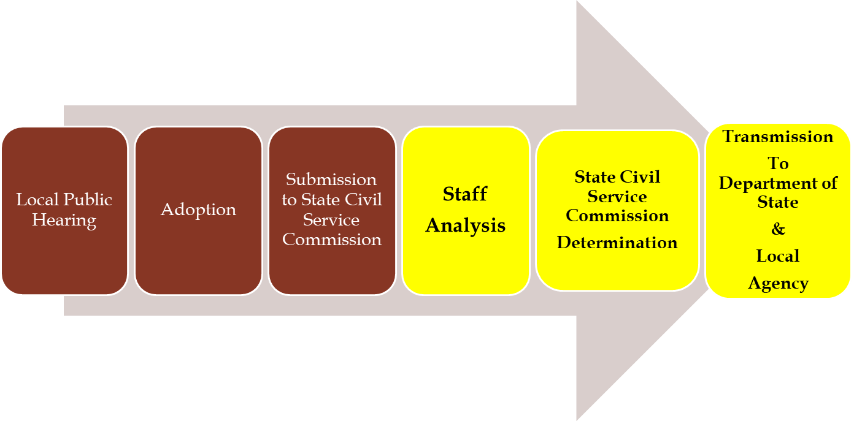
Getting to Yes! Rules Resolutions & Appendices Changes
Review of the Local Resolution Process

Slide 5
Getting to Yes! Rules Resolutions & Appendices Changes
Review of the Local Resolution Process
Section 20 of Civil Service Law:
  Local rules are subject to State Civil Service Commission approval
  Public hearing is generally required
  Do not take effect unless filed with the Secretary of State

Slide 6
Getting to Yes! Rules Resolutions & Appendices Changes
Review of the Local Resolution Process
Local Public Hearing:
Announcement
  Advertise to the public for at least three days
  Notify interested parties requesting written notification 30 days prior to the hearing
  Summarize the details of the proposal
  Document with Affidavit of Publication & Copy of the Announcement(s)

Slide 7
Getting to Yes! Rules Resolutions & Appendices Changes
Review of the Local Resolution Process
Local Public Hearing:
Notification is hereby given that a Public Hearing will be held at (location) at (time) on the matter of amending the Appendices of the Rules for the Classified Civil Service of (County or Municipality Name).

Slide 8
Getting to Yes! Rules Resolutions & Appendices Changes
Review of the Local Resolution Process
Local Public Hearing:
Holding the Hearing
  Time and Place Announced
  Allow Public Comments—Oral and Written
  Produce Minutes

Slide 9
Getting to Yes! Rules Resolutions & Appendices Changes
Review of the Local Resolution Process
Adoption of Resolution
Official Action of the Local Commission or Personnel Officer
  Standardized Format
  Certification Language Required
  Signed by Majority of Commission Members or Personnel Officer

Slide 10
Getting to Yes! Rules Resolutions & Appendices Changes
Review of the Local Resolution Process
Adoption of Resolution
Additional Requirements for Cities
  Subject to Approval by Mayor or Designee
  Failure to Act in 30 Days Considered Approval

Slide 11
Materials to Provide in Support of Proposed Appendices Amendments
Tuesday, June 11, 2024, 1:15 p.m.

Slide 12
Getting to Yes! Rules Resolutions & Appendices Changes
Materials to Provide in Support of Proposed Appendices Amendments
Submission to SCSC
Required Documentation/Submit Electronically
  Resolution
  Copy of the Notice of Public Hearing
  Affidavit of publication from the paper in which the Notice was published
  Minutes from the Public Hearing
  Data Sheet(s)
  Required Supporting Materials

Slide 13
Getting to Yes! Rules Resolutions & Appendices Changes
Materials to Provide in Support of Proposed Appendices Amendments
What Supporting Documents are Required?
Additions – Use Form M-4A
    Baseline information regarding position(s) proposed
    Justification for the proposal
  Additional supporting documentation for the proposed jurisdictional classification
Deletions – Use Form M-4D

Slide 14
How to Justify Your Request
Tuesday, June 11, 2024, 1:15 p.m.

Slide 15
Getting to Yes! Rules Resolutions & Appendices Changes
How to Justify Your Request
Justifications Must:
Explain why it is not practicable to examine for the title.
Identify the legal basis for the title to be placed outside of the competitive class.
Reference the section of civil service law and explain why it is relevant to this specific case.

Slide 16
Getting to Yes! Rules Resolutions & Appendices Changes
How to Justify Your Request
What MSD looks for:
Duties of the position
How the proposal meets the applicable criteria
How the position fits in with the rest of the organization (Org Chart)
Documentation is crucial

Slide 17
How To Justify Your Request:
Unclassified Service

Slide 18
Getting to Yes! Rules Resolutions & Appendices Changes
How to Justify Your Request
Unclassified Service, §35 of CSL:
§35(a) Elective offices
§35(b) All offices filled by election or appointment by the legislature
§35(c) Legislative employees principally involved in legislative function
§35(e) Department heads authorized to:
  Control the functions of a department of government
  Appoint and remove subordinates
§35(f) Members, officers and employees of Boards of Elections
§35(g) Teaching and teaching supervisory staff
§35(i) Community College professional positions approved by the Chancellor

Slide 19
Getting to Yes! Rules Resolutions & Appendices Changes
How to Justify Your Request
Unclassified Service, §35 of CSL:
For all requests except those made pursuant to §35(e), provide:
A written statement of how the requested position satisfies the criteria in §35; and
Local Law/Charter or Board Resolution that supports allocation to the unclassified service

Slide 20
Getting to Yes! Rules Resolutions & Appendices Changes
How to Justify Your Request
Unclassified Service, §35 of CSL:
For all requests made pursuant to §35(e), provide:
A written explanation citing §35(e) of the Civil Service Law;
The local law creating the department; and
The local law designating the position as the head of the department with the authority to direct and control the department, as well as the authority to appoint and remove employees.

Slide 21
How To Justify Your Request:
Exempt Class

Slide 22
Getting to Yes! Rules Resolutions & Appendices Changes
How to Justify Your Request
Exempt Class, §41 of CSL:
§41(1)(b) Deputies of principal officers authorized to act generally for and in place of the principal
§41(1)(c) One secretary to each municipal board or commission
§41(1)(d) One clerk for each elected judge, One clerk and one deputy clerk, if authorized by law, for each court
§41(1)(e) Other subordinate offices or positions for which neither competitive nor non-competitive examination is practicable

Slide 23
Getting to Yes! Rules Resolutions & Appendices Changes
How to Justify Your Request
Exempt Class, §41 of CSL:
§41(1)(b) Deputies of principal officers authorized to act generally for and in place of the principal
Provide:
Jurisdictional classification of the principal
Duties of the principal executive officer
Local law creating the department of which the requested position is the deputy
Local law granting the authority to act for and in place of the principal
Written justification

Slide 24
Getting to Yes! Rules Resolutions & Appendices Changes
How to Justify Your Request
Exempt Class, §41 of CSL:
§41(1)(c) One secretary to each municipal board or commission
Provide:
A written explanation citing §41(1)(c);
Documentation supporting the creation or existence of the municipal board or commission the secretary is serving; and
The local law permitting the appointment.

Slide 25
Getting to Yes! Rules Resolutions & Appendices Changes
How to Justify Your Request
Exempt Class, §41 of CSL:
Section §41(1)(d) One Clerk for each elected judge, one clerk and one deputy clerk of each Court
Provide:
Statement of duties
Written statement Citing §41(1)(d) of Civil Service Law.
Local Law is not required

Slide 26
Getting to Yes! Rules Resolutions & Appendices Changes
How to Justify Your Request
Exempt Class, §41 of CSL:
§41(1)(e) Other subordinate offices or positions for which neither competitive nor non-competitive examination is practicable
Written explanation citing §41(1)(e) and explaining why neither competitive nor non-competitive examination is practicable;
Local law creating the position.
Working with confidential material/holding confidence and trust of the supervisor are not necessarily appropriate justification.
  Compelling evidence of a unique and confidential relationship or other extenuating circumstances must be provided.

Slide 27
How To Justify Your Request:
Non-Competitive Class

Slide 28
Getting to Yes! Rules Resolutions & Appendices Changes
How to Justify Your Request
Non-Competitive Class, §42 of CSL:
§42(1) Positions not practicable to competitively examine
§42(2-a) Policy influencing/confidential positions may be designated as such to provide for exclusion from tenure protection
§42(2) Positions in municipalities with fewer than 5,000 population

Slide 29
Getting to Yes! Rules Resolutions & Appendices Changes
How to Justify Your Request
Non-Competitive Class, §42 of CSL:
§42(1) Positions not practicable to competitively examine
All requests - Written justification citing §42(1) and explaining how examination is not practicable.
Recruitment difficulty – The written justification must include a summary of the last three examinations and eligible lists resulting in non-mandatory situations.
Exam not provided by DCS – The written justification must include the date of the exam request which must have been more than three years prior to the resolution.

Slide 30
Getting to Yes! Rules Resolutions & Appendices Changes
How to Justify Your Request
Non-Competitive Class, §42 of CSL:
§42(2) Positions in civil divisions where the population is under 5,000
Written justification citing §42(2) and explaining how examination is not practicable.
Part Time Positions Only per State Commission policy
  Standards for Non-Competitive Classification in Civil Divisions of Less than 5,000 Population
The civil division must include a notation of “population under 5000” or other symbol designating it as such on the resolution.

Slide 31
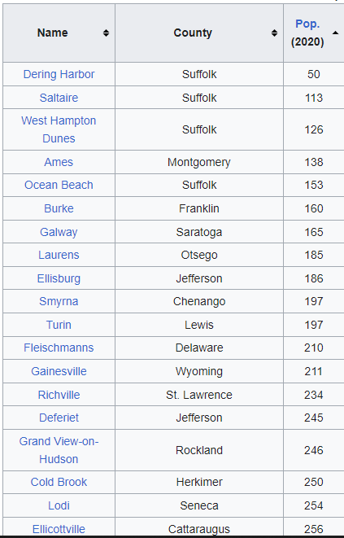
Getting to Yes! Rules Resolutions & Appendices Changes
How to Justify Your Request
§42(2) Positions in civil divisions where the population is under 5,000
There are many villages with populations under 5,000
Population must be documented using census data.

Slide 32
Getting to Yes! Rules Resolutions & Appendices Changes
How to Justify Your Request
Non-Competitive Class, §42 of CSL:
§42(2-a) Positions which are confidential or require the performance of functions influencing policy.
A written explanation citing §42(2-a) and why competitive examination is not practicable with specific aspects of the position that cannot be tested
  Without specifics, the request may be viewed as flawed by the state commission.
Title must include an identifying symbol on the resolution denoting its policy influencing/confidential nature.

Slide 33
How To Justify Your Request:
Labor Class

Slide 34
Getting to Yes! Rules Resolutions & Appendices Changes
How to Justify Your Request
Labor Class, §43 of CSL:
Unskilled positions
No qualifications established by civil service
    No licenses required
Duties impracticable to examine

Slide 35
Getting to Yes! Rules Resolutions & Appendices Changes
How to Justify Your Request
Labor Class, §43 of CSL:
§43(1) All unskilled laborers
Written justification citing §43(1) of the Civil Service Law.
The position must not have minimum qualifications.

Slide 36
NY HELPS
Jurisdictional Classification
Questions

Slide 37
Getting to Yes! Rules Resolutions & Appendices Changes
NY HELPS Jurisdictional Classification Questions
The NY HELPS Process
Identify titles that meet NY HELPS Criteria
Adoption and Submission of Rules Resolution
Approval by SCSC & Filing with Secretary of State (90 days)
Make NC Appointments to Approved Titles
Explore Options for Permanent Competitive
Deletion of All NY HELPS Titles from Rules Upon Expiration of the Program

Slide 38
NY HELPS Jurisdictional Classification Questions:
Granting NY HELPS Employees Competitive Class Status

Slide 39
Getting to Yes! Rules Resolutions & Appendices Changes
NY HELPS
Granting NY HELPS Employees Competitive Class Status through appointment to higher-level title
Higher-level position is also an NY HELPS non-competitive position
Higher-level position not yet added to NY HELPS but meets the NY HELPS criteria
Via examination
  Promotion
  Open-competitive
  Non-competitive promotion

Slide 40
Getting to Yes! Rules Resolutions & Appendices Changes
NY HELPS Jurisdictional Classification Questions
Granting NY HELPS Employees Competitive Class Status
Higher-level position is also an NY HELPS non-competitive position
If you have higher-level positions in the non-competitive class, appointing authorities can “promote” (appoint) NY HELPS employees to the higher-level title if the minimum qualifications are met.
Benefits – could aid in retention by granting employees higher salary.
Cons – does not provide competitive status to employee

Slide 41
Getting to Yes! Rules Resolutions & Appendices Changes
NY HELPS Jurisdictional Classification Questions
Granting NY HELPS Employees Competitive Class Status
For Example:
Social Welfare Examiner (HELP Program)
Senior Social Welfare Examiner (Help Program)

Slide 42
Getting to Yes! Rules Resolutions & Appendices Changes
NY HELPS Jurisdictional Classification Questions
Granting NY HELPS Employees Competitive Class Status
B) Higher-level position not yet added to NY HELPS but meets the NY HELPS criteria
Same as A) but the local civil service agency would need to go through the rules process and ensure the criteria are satisfied
Cons – employees may need to be appointed on a temporary or provisional basis to the higher-level title while resolution is processed.

Slide 43
Getting to Yes! Rules Resolutions & Appendices Changes
NY HELPS Jurisdictional Classification Questions
Granting NY HELPS Employees Competitive Class Status
For Example:
Social Welfare Examiner (HELP Program)
Senior Social Welfare Examiner

Slide 44
Getting to Yes! Rules Resolutions & Appendices Changes
NY HELPS Jurisdictional Classification Questions
Granting NY HELPS Employees Competitive Class Status
C) Via promotion examination pursuant to §52.1
  Direct line quals or collateral quals
  Typically, “Amount of time in lower-level competitive class title”
  §52.12 provides that you can offer promotion exams to non-competitive class employees if you provide an OC back-up.
  Benefits – NY HELPS employees can participate in promotion exams.
  Other – If employees fail, they can remain in n/c lower-level position.

Slide 45
Getting to Yes! Rules Resolutions & Appendices Changes
NY HELPS Jurisdictional Classification Questions
Granting NY HELPS Employees Competitive Class Status
For Example:
Senior Social Welfare Examiner
52.12 + OC Backup
Social Welfare Examiner (Help Program) Non-Competitive

Slide 46
Getting to Yes! Rules Resolutions & Appendices Changes
NY HELPS Jurisdictional Classification Questions
Granting NY HELPS Employees Competitive Class Status
C) Via examination
  Open-competitive – An appointing authority can request, and exam be offered on an OC basis only pursuant to §51.1
  Pros – lower-level NY HELPS employees can take higher-level OC exam. If they pass, can be promoted via §52.7
  Cons – lower-level employees may need to be provisionally or temporarily promoted while exam results are processed. If not successful, can be returned to lower-level NY HELPS title.

Slide 47
Getting to Yes! Rules Resolutions & Appendices Changes
NY HELPS Jurisdictional Classification Questions
Granting NY HELPS Employees Competitive Class Status
For Example:
Depending on the number of vacancies and candidates, NC candidates may be able to be appointed via 52.7
Senior Social Welfare Examiner (1 vacancy)
OC Exam – 51.1
Social Welfare Examiner (Help Program) Non-Competitive (2 employees)
Social Welfare Examiner Competitive (1 employee)

Slide 48
NY HELPS Jurisdictional Classification Questions:
Deleting NY HELPS Titles by Resolution

Slide 49
Getting to Yes! Rules Resolutions & Appendices Changes
NY HELPS Jurisdictional Classification Questions
Granting NY HELPS Employees Competitive Class Status Through Rules Resolution Process:
Deleting the title will grant permanent competitive class status once approved by SCSC and filed with Secretary of State.
In the short term, this should be viewed as a last resort!
Deletion of NY HELPS titles is required when the program expires.

Slide 50
Getting to Yes! Rules Resolutions & Appendices Changes
NY HELPS Jurisdictional Classification Questions
Granting NY HELPS Employees Competitive Class Status Through Rules Resolution Process:
Deleting NY HELPS titles by Resolution
Pro – employee is not required to take an exam
Con – Increased workload civil service

Slide 51
In Conclusion

Slide 52
Getting to Yes! Rules Resolutions & Appendices Changes:
In Conclusion
When seeking to convert NY HELPS appointees from Non-Competitive to Competitive:
  Exhaust all promotion possibilities first.
  Deleting the title from your rules should be viewed as a last resort.
  All NY HELPS titles must be deleted when the program expires.

Slide 53
Getting to Yes! Rules Resolutions & Appendices Changes:
In Conclusion
When submitting a rules resolution, avoid:
  Not providing copies of/references to laws
  Providing laws that do not refer to the requested title
  Providing laws that limit authority in a way that does not meet CSL criteria
  Requesting unlimited positions in an exempt title
  Requesting non-competitive titles in singular form when multiple positions are needed

Slide 54
Getting to Yes! Rules Resolutions & Appendices Changes:
In Conclusion
When submitting a rules resolution, avoid:
Submitting requests based on recruitment difficulty which are not supported by recruitment information
Submitting requests for full-time non-competitive titles based on under 5,000 policy
Submitting requests for labor class positions that require qualifications

Slide 55
Getting to Yes! Rules Resolutions & Appendices Changes:
In Conclusion
How you can help:
Check your submission for completeness before submission
Break larger resolutions up into smaller resolutions
  Smaller resolutions process more quickly
    <5 titles per resolution optimum
  It is not uncommon for a resolution of 15 amendments to be held up because of problems that concern only one or two of the amendments

Slide 56
Writing Successful Rules Resolutions
Questions?
You can always contact us:
    Commission.ops.mun@cs.ny.gov
    Telephone: 518-473-5221

