Slide 1
Merit System Transformation

Slide 2
Jessica Rowe, Deputy Commissioner for Merit System Operations
First job with New York State: Planting Flowers at Saratoga Spa State Park
Intern to Director of Staffing Services (and every position in between)-19 years with Civil Service!
Deputy Commissioner of Merit System Operations: Staffing, Testing, Employee Health Services

Slide 3
Values and Perspective
My Values: Compassion, Collaboration, Communication, Creativity
Customer Focused: Civil Service staff, job seekers, employees, state agencies and local municipalities (You!)
Urgency to meet the immediate and long-term recruitment and retention needs in New York State

Slide 4
Local Concerns
Timeliness: Exam schedule and test results
Communication: Exam scope releases and direct communication
Tracking: Return of test materials
Your frustrations are heard, understood and will be met with action.
Long-term, these concerns will be mitigated with
merit system transformation.

Slide 5
Vision of the Future
In order to truly transform the way New York State recruits and retains talented and diverse individuals into the State workforce, we must radically change the recruitment and hiring experience. This includes fundamental changes to the recruitment, application, examination, and post-test experiences.

Slide 6




Transforming New York State’s Recruitment and Retention to Cultivate a Talented
and Diverse Workforce for Future Generations
Centers for Careers
in Government
Public Service Matters Campaign
Continuous Recruitment Examinations

Slide 7
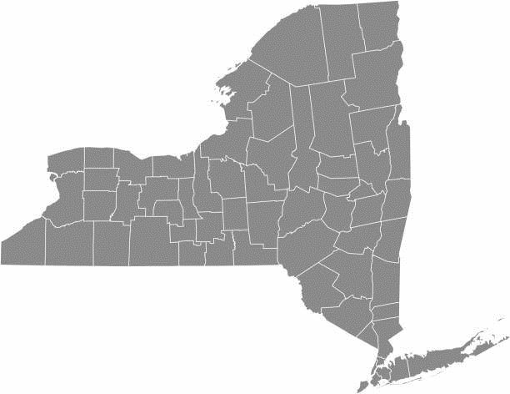
FY 2024/2025 Testing Centers
BUFFALO
SYRACUSE
COHOES
MANHATTAN
ROCHESTER

Slide 8

Mindset Shift: Modernization to Transformation
Modernization: Means updating or replacing systems and processes in a way that enhances performance but does not fundamentally change the way we currently work.
Transformation: Means creating a robust new business model and fundamentally changing the way we manage our work.

Slide 9

Goals of Merit System Transformation
Increase opportunities for interested individuals to compete for positions in public employment.
Enable New York State to be more competitive with the private sector in its recruitment efforts while simultaneously providing better services to all New Yorkers.
Create refreshed talent pools of diverse, highly qualified candidates to State agencies and local municipalities.
Eliminate rigid structures that are barriers to entry for jobseekers; streamline this process for all agencies.
Outcome: Hire talented and diverse candidates in a compressed timeframe from application to employment

Slide 10
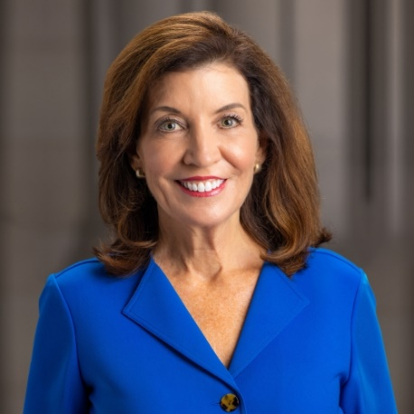
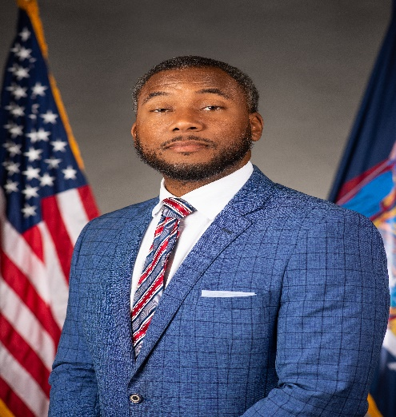
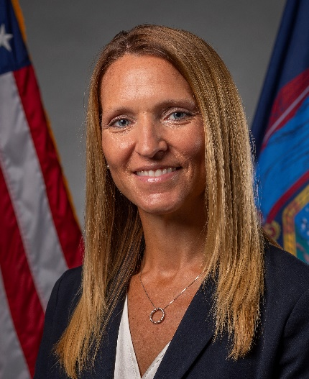
Merit System Transformation Champions
Governor Kathy Hochul Commissioner Hogues Executive Deputy Commissioner Corso
#TeamCivilService

Slide 11
Local Agency Survey
Survey sent out in May to all conference participants, 76 respondents
Municipalities are the first stakeholders invited to the table!
Questions
Obstacles to success and support to achieve success
Ideal recruitment experience, application process, post-test experience
Assessing merit and fitness in 2024 beyond

Slide 12
Transformation Discussion
Goals: Dig deeper, encourage innovation, look at challenges from a different point of view (local government, local candidates, local appointing authorities)
Ground Rules: Everyone’s ideas count, don’t criticize another person’s ideas, ask for clarification if you don’t understand the idea, share time with all participants
Facilitator and Scribes: Talented Civil Service Staff who will facilitate the group discussion and take notes for future use

Slide 13

Wrap Up/Report Out
Select one person to report out for your group
on one idea generated.

Slide 14
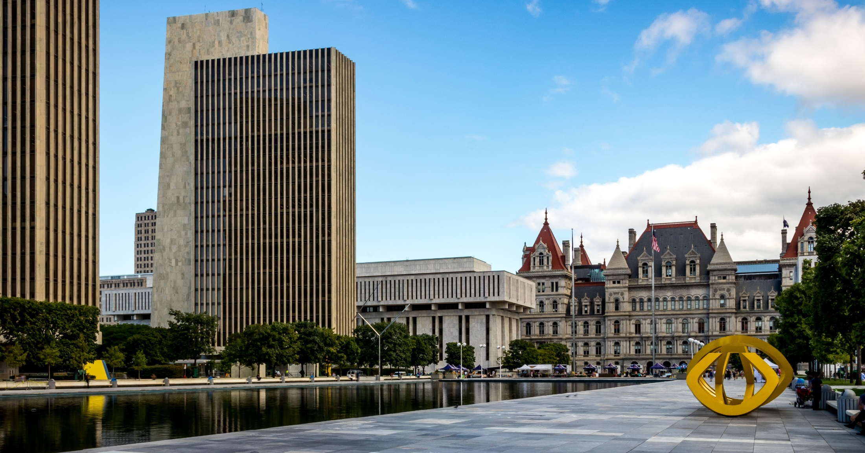
Jessica Rowe
Deputy Commissioner for Merit System Operations
Jessica.Rowe@cs.ny.gov
518-473-9539

