Slide 1
Q&A Roundtable Discussion
Wednesday, June 12, 2024
Maria Kenneally & Elena O’Kane

Slide 2
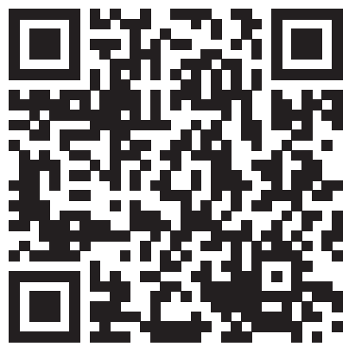
PAR 07-23
Workforce Demographic Data Collection Initiative and Requests for Data

Slide 3
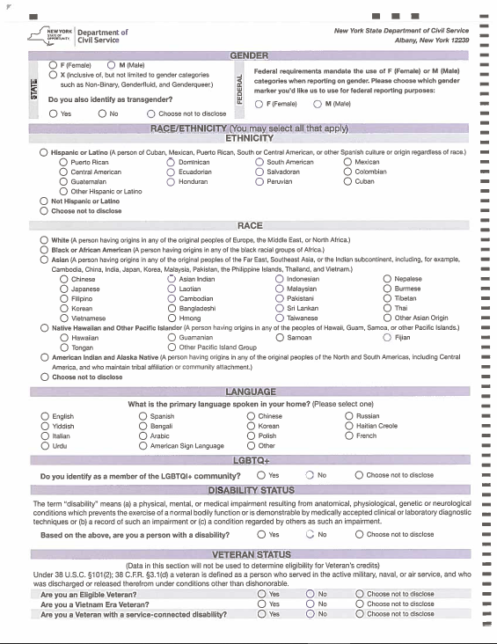
NY HELPS Program Evaluation
When?
  July 31, 2024
Where?
  Assistance.request@cs.ny.gov
Who?
  All HELP or NY HELPS appointments

Slide 4
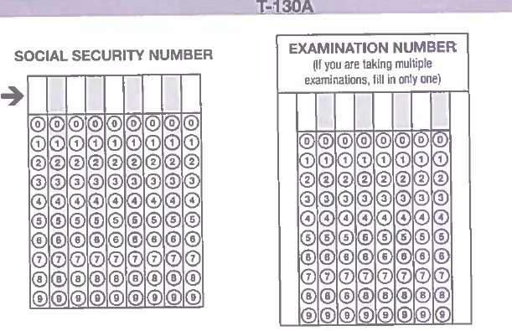
NY HELPS Program Evaluation
Gender
Race/Ethnicity
Language
Disability Status
Veteran Status
LGBTQ+

Slide 5
Police Transfers
PAR 14-23
Section 58(5) of the Civil Service Law
Section 70(1) of the Civil Service Law

Slide 6
Police Transfers - Who Can Transfer?
A member of the New York Police Department (NYPD)
(requires additional training)
A member of the New York City Department of Environmental Protection (NYC-DEP)
(does not require additional training)
A Police Officer in the New York State Department of Environmental Conservation (ENCON)
SUNY Police
New York State Park Police

Slide 7
Police Transfers - Who Cannot Transfer?
New York State Troopers
Police Officers employed by the MTA (Metropolitan Transit Authority)
Police officers employed by the Port Authority of New York and New Jersey
Out-of-State Police Officers
Police Officers appointed to non-competitive class positions

Slide 8
Questions about Police Transfers?
Appropriate Forms or Roster Record
Email assistance.request@cs.ny.gov
Review the Frequently Asked Questions document.

Slide 9
Helpful Tips - Police Transfer Requests
Examination Appropriateness Request Form (M-440)
Procedure for Municipal Civil Service Agency Staff - Examination Appropriateness Request

Slide 10

2024 Civil Service Institute

Slide 11
Layoffs - Extension of Rights
Various sections of the Civil Service Law were amended by Chapter 676 of the Laws of 2023. These changes impact the layoff rights of classified service employees under your agency’s jurisdiction effective February 19, 2024. This memo supersedes CL-17-02 regarding the responsibilities of a local civil service agency in the event of a layoff.

Slide 12
Layoffs - Extension of Rights
What are the changes?
  Non-competitive Class
  Labor Class
Review:
  Police Layoffs
  PAR 03-18

Slide 13
Layoffs - Extension of Rights
Publications Updated
Send questions to assistance.request@cs.ny.gov

Slide 14


