Slide 1
Your Payroll Please?!
Jason Laird & Richard Lonergan
Tuesday, June 11, 2024

Slide 2
What We Will Cover
The Legal Basis for Payroll Certification
The 5 W’s of Payroll Certification
  Why, What, Who, When, Where
How To Make Payroll Certification Work

Slide 3
Why?

Slide 4
Legal Basis
Civil Service Law
  §95—Compliance
  §97—Transaction Reporting And Roster Maintenance
  §100—Certification
  §101-102—Penalties And Court Proceedings

Slide 5
Legal Basis
Civil Service Rules
  Timeframes
  Conditions Of Certification
  Certification And Enforcement Procedures

Slide 6
What?

Slide 7
What Is Payroll Certification, Really?
Key Element Of Transaction Management
Enforcement Mechanism
  Identifying & Correcting Non-compliance
Internal Control
  Roster Inaccuracies & Process Issues
Effective Payroll Certification Protects Both Public Employers And Employees

Slide 8
General Payroll Certification Process
Civil Service Requires Payroll
Appointing Authority Provides Payroll
Payroll Compared to Roster
Discrepancies Identified & Communicated to Appointing Authority
Discrepancies Resolved
Certification Issued

Slide 9
Who?

Slide 10
Who Is Involved In Payroll Certification?
Appointing Authority
  Required To Report All Transactions To Civil Service
  Must Provide Payrolls Upon Request
  Must Comply With Law And Rules
Civil Service
  Certification In Accordance With Law And Rules
  Resolves Discrepancies
  Enforces Compliance

Slide 11

Who Does It Benefit?
Employees
    Clarifies status
    Protects rights
Civil Service
    Ensures accuracy of the official roster
    Enables improvements in transaction management processes
Appointing Authorities
    Avoids long-term issues

Slide 12
Who Should Be On The Payroll?
All Classified Service Employees
  State Comptroller Opinion 74-1118—Payments For Personal Services On Approved Payrolls
  Payroll Method Deemed Efficient And Conducive To Proper Accounting For Deductions
What About Independent Contractors?
  Contracts Subject To Civil Service Review

Slide 13
Where?

Slide 14

Where Can The Payroll Be Found?
Current Fiscal Year Payrolls
    Town Supervisor
    Village Clerk
    County Treasurer
Previous Year(s) Payrolls
    Records Retention Officer

Slide 15
When?

Slide 16
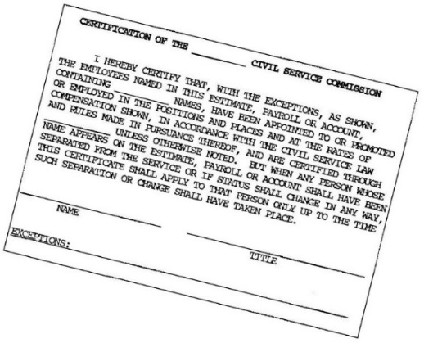
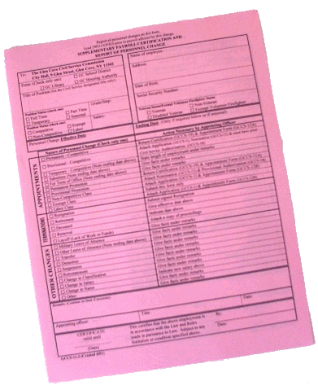
When Is Payroll Certification Required?
All employees in the classified service must be under Civil Service certification at all times during the year.

Slide 17

When Is Payroll Certification Required?
Whenever a Personnel Change Occurs
  Interim Certification
General Certification Of All Employments
  At Least Once Every 12 Months
  Local Rules May Require Additional Certifications

Slide 18
How?

Slide 19
Do You Recognize This Form?

Slide 20
Do You Recognize This Form?
Be Proactive!!!! ?!
Look at your Payroll Records
Find a Provisional Appointment?
  Do they have :
    Prior Competitive Status?
    Prior experience in another Civil Division?
    If so, they might be able to be either:
      Reinstated
      Transferred
…...instead of being Appointed Provisionally

Slide 21
Basic Process Requirements
Appointing Authorities:
  Report all transactions
  Provide payrolls to civil service upon request
  Comply with the provisions of Civil Service Law and Rules

Slide 22

What To Check
Name
Official Civil Service Title
Salary/Salary within Grade
YTD Salary (Part-Time Rule)
Retirement System Type
This Photo by Unknown Author is licensed under CC BY-SA
This Photo by Unknown Author is licensed under CC BY-SA

Slide 23
How To Certify A Payroll
Compare The Payroll Against The Roster
  Roster Is The Authoritative Record
Certify That Employment(s) Are In Compliance
Note Discrepancies And Information Needed To Resolve Them
Take Corrective Action If Necessary
  Document Your Process

Slide 24
When Issues Are Identified
Not All Discrepancies Are Intentional Non-compliance
  Procedural Deficiencies
  Misunderstanding/Miscommunication
Corrective Action Doesn’t Need To Be Punitive
  Review Procedures
  Training
You Have Options—Consider The Situation

Slide 25
Types Of Certifications
Extended
  Last for a Set Duration
  Effective As Long As No Personnel Changes Occur
LIMITED
  Should Not Exceed 30 Days
Certifications May Be Rescinded At Any Time

Slide 26
Taking Corrective Action
Notify Appointing Authority In Writing
Be Specific
  What Is The Issue?
  What Do You Need From The Appointing Authority?
  What Is The Deadline?
  What Is The Consequence Of Non-compliance?
  Set A Deadline
Be Clear About The Status Of The Employment Cited
Use Your Best Judgement

Slide 27
Following Up
Be Timely And Document The Effort
Be Specific
  What Information Or Action Is Needed?
  What Was The Original Deadline?
Be Clear About Where Things Stand
  What Action Is Civil Service Taking Now?
  What Will Happen Next?

Slide 28
Final Corrective Action
Notification In Writing
Specify
  Issues Cited
  Effort Made To Resolve Issues
  Outcome/Determination Made
Be Clear About:
  Status Of Employments Cited
  Consequence Of Non-compliance

Slide 29
What Are The Potential Consequences?
Misdemeanor
Liability For Payments Made Following Exception
  Appointing Authority & Disbursing Officer
Legal Action To Recover Payment May Be Brought By The Civil Service Agency Or Any Taxpayer

Slide 30
Successful Strategies
Regular Contact With Appointing Authorities
Know Who To Talk To & Do It Frequently
Provide Orientation And Training to Appointing Authorities to Allow for Advance Problem Solving
Clearly Communicate Problems, Deadlines and Potential Consequences to improve Responsiveness
Always Follow-Up on the Deadlines that You Set

Slide 31
Successful Strategies
Make Certification Routine
Make Sure Your Certification Schedule Is “Doable,” Amend Rules If Necessary
Certify Individual Transactions As Well As Regular General Certifications
Payroll Certification Should Be Ongoing And Part Of Your Daily Business. Don’t Let The RPC’s Pile Up.
Always Take Action When Necessary

Slide 32


