Slide 1

Civil Service
Speed Learning
June 2025
Notes:
Intro

Slide 2

TOUR OF MSD ONLINE
Rashawn King
June 4, 2025

Slide 3

COMMUNICATING
WITH MSD
Richard Lonergan
June 4, 2025
Notes:
Asking for help can be hard. We have all been there. This presentation (and it accompanying handouts) are intended to help you communicate with use here at MSD successfully.

Slide 4

NY JUNE CONFERENCE 2025
Information Memorandum IM-01-24
IM-01-24: Exam Related Correspondence Guide
IM-01-24 Suggests how to create simple messages which can be understood and processed quickly for exam related correspondence.
  This presentation will allow you to use IM-01-24 to create simplified non-exam related correspondence
  The there are two correspondence guides (which have changed):
    ➊ Exam-Related Correspondence Guide: a list of who to contact about specific exam issues
      …and the focus of our presentation today:
    ➋ Common Exam-Related Email Correspondence Guide: how to write a message
        With the information in a uniform context
        With all that needs to be communicated
DEPARTMENT OF CIVIL SERVICE
4
Notes:
The process of creating a copy and paste format template by MSD was initiated in 2023 and was disseminated to civil service agencies in IM-01-24. This was intended to serve as a format to assist municipal civil service agencies in communicating with MSD in an efficient manner. By explicitly defining the agency involved, also known as the intended audience of this presentation, the specific area of the agency’s inquiry, which is generally known as the distinctly explicit reason why a civil service agency might be attempting to reach out to us here at MSD and the quantitative specificities which would set a specific inquiry apart from all other inquires, which non-specialists might describe as “those things with numbers which have some sort of meaning to our records,” before advancing to the qualitative specifics of the matter at hand, also known as “the important stuff that cannot be recorded with a seemingly random collection of numbers or a QR code.” It is a generally accepted practice to write this portion of the email message in a way which one might compose a diary entry with the certain expectation that it might be read by a researcher a century from now. Please watch out for typographic errors, we strongly discourage communicating to MSD using voice to text, especially while driving. The question format found in IM-01-24 permits both civil service agencies and MSD to address each other using a method of correspondence which can permit both parties to understand what the message/question is based upon the principle of a common pattern and method. This is also known as a prescription to make our lives easier.

Slide 5


NY JUNE CONFERENCE 2025
ENCOUNTER
1: Identify the Problem/Question
Ⓐ Refer to MSD’s Online Manuals
Ⓑ Check your Rules and Policies
Ⓒ Refer to MSD’s Memoranda (PARs and IMs)
Ⓓ Seek advise from legal counsel
REFER TO
MSD ONLINE
2:
DECIDE HOW TO PROCEED
Ⓐ Technical Assistance
Or
Ⓑ MSD Exams
3: Contact
DEPARTMENT OF CIVIL SERVICE
5
Notes:
When it comes to these questions, we have created this three-step process of how to begin to compose a message to MSD.

Slide 6
NY JUNE CONFERENCE 2025
Ⓐ Exam Related Questions: msdexams@cs.ny.gov
Ⓑ Non-Exam Questions: assistance.request@cs.ny.gov
WHO TO CONTACT?
3:
➊ Refer to MSD’s Common Exam- Related Email Guide.
➋ Check to make sure that your exam questions are directed towards the correct address
➌ If you do not know where to send it, send it to MSDexams@cs.ny.gov
EXAM RELATED? REFER TO EMAIL GUIDE
3A:
➊ Refer to the exam correspondence guide to find a suggested format for your questions.
➋ Place the reason for your email in the subject line.
NON-EXAM RELATED?
3B:
DEPARTMENT OF CIVIL SERVICE
6
Notes:
Once you have determined who to contact here at MSD, we would then advise that you follow the following model/template for sending a message here to MSD.

Slide 7
NY JUNE CONFERENCE 2025
What Should go to msdexams@cs.ny.gov?
Questions about:
Notices of Intent
Exam request Title Change
Late Candidate Counts
Late Exam Requests
Missing Exam Scopes
Scope Objections
Cancel an Exam
Exam Schedule
Late or Missing Exam Materials
Keeping Alternate Test Materials
Critical Incident Report
Scores Release Date
Missing Exam Score
Removal of Candidate from Exam Scores
Re-Release of Exam Scores
Un-submit Candidate from T&E Exam
Exam Fee Billing
Local Exam Process Issue
Positions filled through the NY HELPS Program in local government to date.
DEPARTMENT OF CIVIL SERVICE
7
Notes:
We here at MSD get many questions about exams.
These types of questions are the most common ones which we will receive from civil service agencies about exam-related matters. To make everyone’s lives easier, we created model email messages so that we can understand your questions and provide timely answers to your questions. The first, and most important step of this process is to help you speed up the process of writing up your questions to us here at MSD.

Slide 8
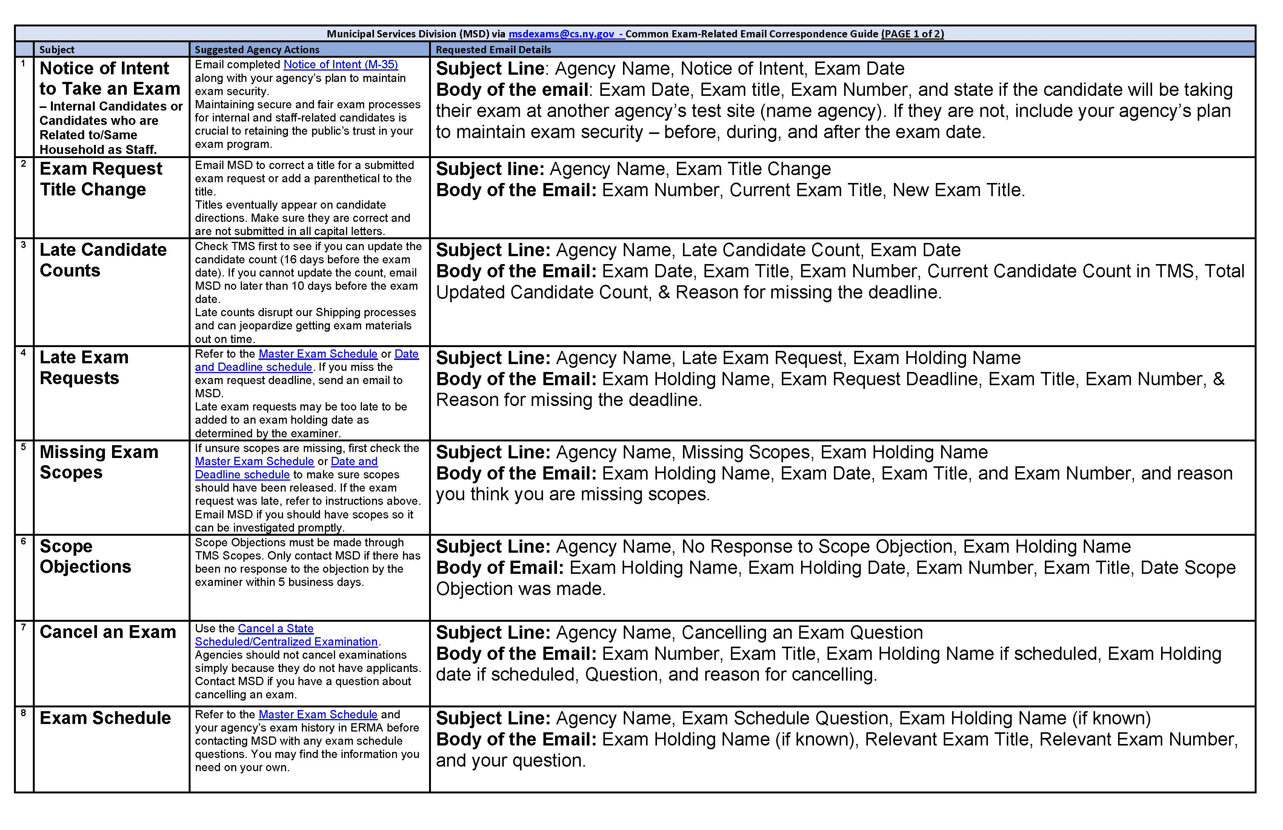
NY JUNE CONFERENCE 2025
1: Identify the Problem
DEPARTMENT OF CIVIL SERVICE
8
Notes:
This here, is a handout of how to compose messages for MSD for the following sixteen most common exam-related questions. By putting in the information as is found in the above slide which is most relevant to your current situation, you can use this as a pattern to communicate to us in the most efficient manner possible.
Everyone has this handout, correct?

Slide 9
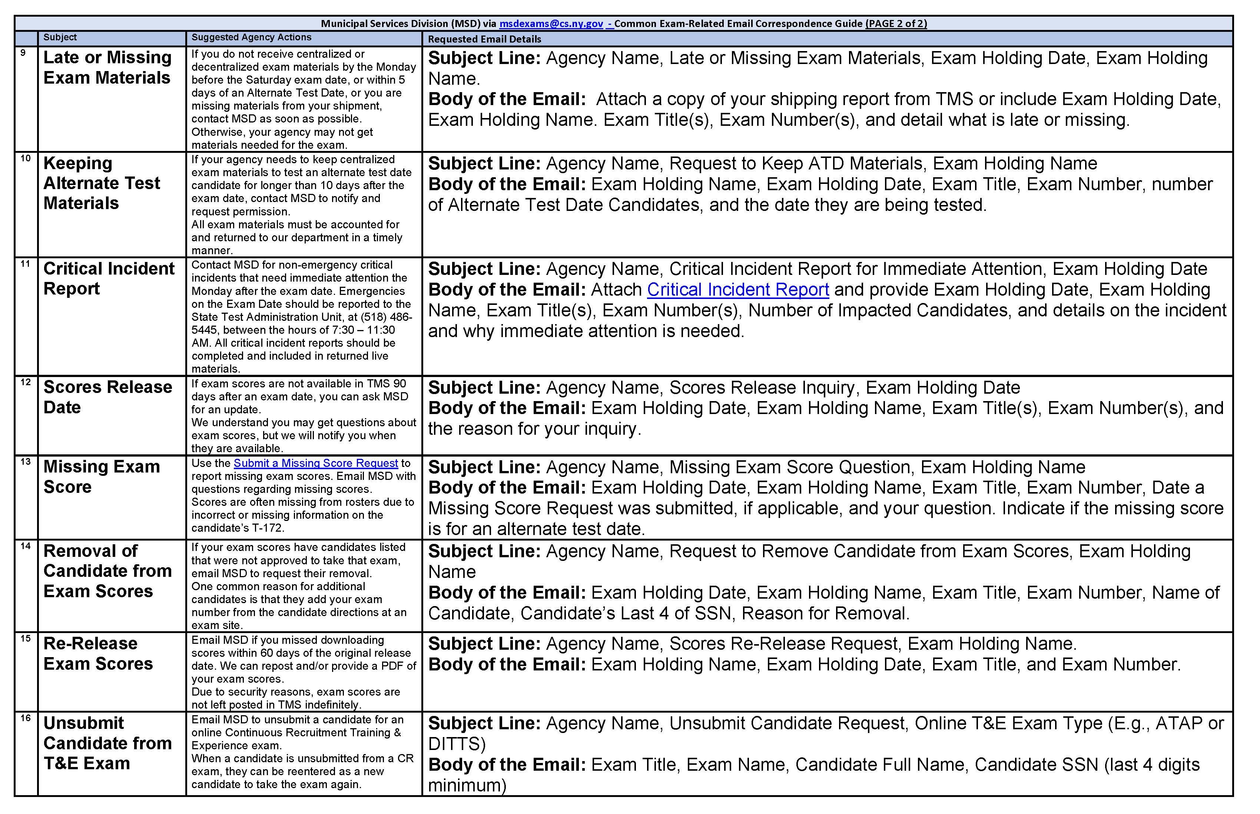
NY JUNE CONFERENCE 2025
1: Identify the Problem
DEPARTMENT OF CIVIL SERVICE
9
Notes:
These questions as a model permit the user to explain why you are reaching out to MSD, and to tell us what you wish for MSD to execute upon your behalf.

Slide 10
NY JUNE CONFERENCE 2025
What Should an Exam Related Email to MSD Exams Look Like? (Example: Scores Release Date)
➊ Subject Line: [AGENCY NAME], Scores Release Inquiry, [EXAM HOLDING DATE]
➋ Body of Email: To whom it may concern at MSD,
It has been more than 90 days since the [CIVIL SERVICE AGENCY] held the [HOLDING NAME] Exams and we are unable to view the exams scores in TMS for the following:
Exam Holding Date: [EXAM HOLDING DATE]
Exam title(s): [EXAM TITLE/EXAM TITLES]
Exam Number(s) [EXAM NUMBER/EXAM NUMBERS]
Reason for your inquiry: [INSERT REASON/REASONS HERE]
➌ [YOUR CONTACT INFORMATION HERE]
Positions filled through the NY HELPS Program in local government to date.
DEPARTMENT OF CIVIL SERVICE
10
Notes:
When writing a message to MSD it is best to follow the format found above, as it helps us understand your question faster. By clearly stating the specific reason why your agency is contacting us here at MSD, we can convey this as fast as possible to the stakeholders or knowledge subject experts who will be able to most appropriately address your question. When we have this basic information to direct our efforts in the general direction you wish for us to proceed, so as to resolve your question, we can apply the contextual information found in the section found in the reason for your inquiry to specifically resolve and conclude your question. We also need your contact information so that we can properly answer your question, because you, not your coworker, your direct report, or your supervisor, deserve an answer to your question.

Slide 11
NY JUNE CONFERENCE 2025
What Should an Exam Related Email to MSD Exams Look Like? (Example: Scores Release Date)
➊ Subject Line: [AGENCY NAME], Scores Release Inquiry, [EXAM HOLDING DATE]
➋ Body of Email: To whom it may concern at MSD,
It has been more than 90 days since the [CIVIL SERVICE AGENCY] held the [HOLDING NAME] Exams and we are unable to view the exams scores in TMS for the following:
Exam Holding Date: [EXAM HOLDING DATE]
Exam title(s): [EXAM TITLE/EXAM TITLES]
Exam Number(s) [EXAM NUMBER/EXAM NUMBERS]
Reason for your inquiry: [INSERT REASON/REASONS HERE]
➌ [YOUR CONTACT INFORMATION HERE]
Positions filled through the NY HELPS Program in local government to date.
WE REALLY NEED THIS
DEPARTMENT OF CIVIL SERVICE
11
Notes:
[Duplicate Slide—Addition of yellow arrow]
When writing a message to MSD it is best to follow the format found above, as it helps us understand your question faster. By clearly stating the specific reason why your agency is contacting us here at MSD, we can convey this as fast as possible to the stakeholders or knowledge subject experts who will be able to most appropriately address your question. When we have this basic information to direct our efforts in the general direction you wish for us to proceed, so as to resolve your question, we can apply the contextual information found in the section found in the reason for your inquiry to specifically resolve and conclude your question. We also need your contact information so that we can properly answer your question, because you, not your coworker, your direct report, or your supervisor, deserve an answer to your question.

Slide 12
NY JUNE CONFERENCE 2025
What Should go to MSD Assistance.Request@cs.ny.gov?
Questions about:
➊ 211 Waivers
➋ Annual Report
➌ Comparability Requests M-440
➍ CSA Staff Changes
➎ Director of Facilities Exam
➏ Layoffs
➐ Permission Request-MSD or TMS Access Support
➑ Position Classification
➒ Comparability Requests M-440
➓ Rules Resolutions
⓫ Transactions
⓬ Veterans’ Issues
⓭ Executive Order 47.3
⓮ Other
DEPARTMENT OF CIVIL SERVICE
12
Notes:
On the other hand, when we remove the cohort of the category of questions which are exam related, we here at MSD have fourteen types of non-exam-specific related questions. We will conclude here with an example, a model message about Comparability Requests.

Slide 13
NY JUNE CONFERENCE 2025
What Should an Email on a non-Exam Related Topic Look Like? (Example: Comparability/M-440)
➊ Subject Line: Agency Name, Request for Comparabilities, M-440
➋ Body of Email: To whom it may concern at MSD,
Attached to this email is an Examination Appropriateness Request Form to request technical assistance from MSD to determine if a
|✖| Transfer | | Reinstatement | | Appropriate Eligible List Use | | Non-Competitive Promotion | | Voluntary Demotion | | Preferred Eligible List Use
is appropriate. The attachments include the required supporting documentation for the
|✖| “From” Title Classification Specification |✖| “From” Title Examination Announcement |✖| “To” Title Classification Specification |✖| “To” Title Examination Announcement
[ INSERT ANY NEEDED CONTEXT HERE. ]
➌ [YOUR CONTACT INFORMATION]
Positions filled through the NY HELPS Program in local government to date.
DEPARTMENT OF CIVIL SERVICE
13
Notes:
As can be seen here, this message makes it clear who it is why is sending this message to us here at MSD and why it is that an agency is sending us this message. If the request is connected to a specific form, please place the form number, such as M- DASH – ” Alef Bet Gimmel “ in the subject line of the email. [PAUSE] (I know, those are letters of an alphabet—just not the English one—I do not wish to show favoritism to any specific form.) This will assist your record keeping, as well as composing this message to us here at MSD, as it will help you to make sure that your message contains all the information we require to answer your question satisfactorily. Please don’t forget your contact information.

Slide 14
NY JUNE CONFERENCE 2025
What Should an Email on a non-Exam Related Topic Look Like? (Example: Comparability/MUN-440)
➊ Subject Line: Agency Name, Request for Comparabilities
➋ Body of Email: To whom it may concern at MSD,
Attached to this email is an Examination Appropriateness Request Form to request technical assistance from MSD to determine if a
|✖| Transfer | | Reinstatement | | Appropriate Eligible List Use | | Non-Competitive Promotion | | Voluntary Demotion | | Preferred Eligible List Use
is appropriate. The attachments include the required supporting documentation for the
|✖| “From” Title Classification Specification |✖| “From” Title Examination Announcement |✖| “To” Title Classification Specification |✖| “To” Title Examination Announcement
[ INSERT ANY NEEDED CONTEXT HERE. ]
➌ [YOUR CONTACT INFORMATION]
Positions filled through the NY HELPS Program in local government to date.
WE REALLY NEED THIS
DEPARTMENT OF CIVIL SERVICE
14
Notes:
[Duplicate Slide—Addition of yellow arrow]
As can be seen here, this message makes it clear who it is why is sending this message to us here at MSD and why it is that an agency is sending us this message. If the request is connected to a specific form, please place the for number, such as M- DASH – Alef Bet Gimmel in the subject line of the email. [PAUSE] (I know, those are letters of an alphabet—I do not wish to show favoritism to any specific form.) This will assist your record keeping, as well as composing this message to us here at MSD, as it will help you to make sure that your message contains all the information we require to answer your question satisfactorily. Please don’t forget your contact information.

Slide 15
Notes:
Thank you. If you have any further questions in this matter, please reach out to us here at MSD.

